Slide 1
Counting individual objects (one-to-one correspondence)
Lesson 1 of 4
Numeracy: Number - Building Understanding
Helen

Slide 2
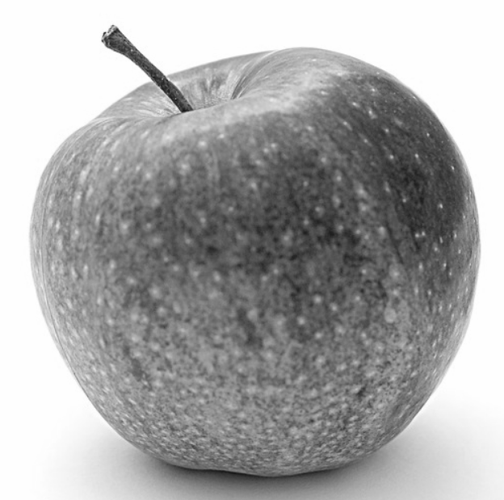
How many apples?
Images from Pixabay

Slide 3
How many apples?
Images from Pixabay

Slide 4
How many apples?
Images from Pixabay

Slide 5
How many apples?
Images from Pixabay

Slide 6
How many apples?
Images from Pixabay

Slide 7
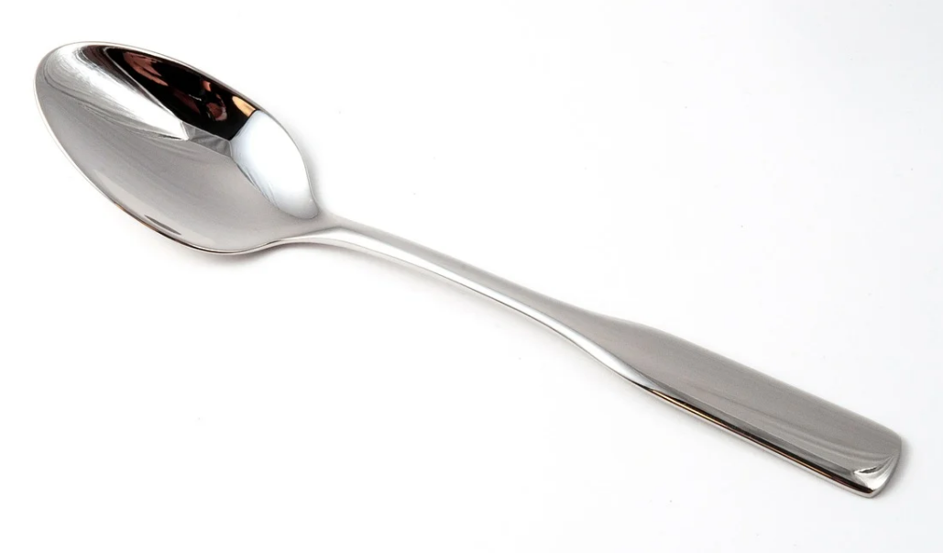
How many spoons?
Draw them in a line and count them
Images from Pixabay

Slide 8
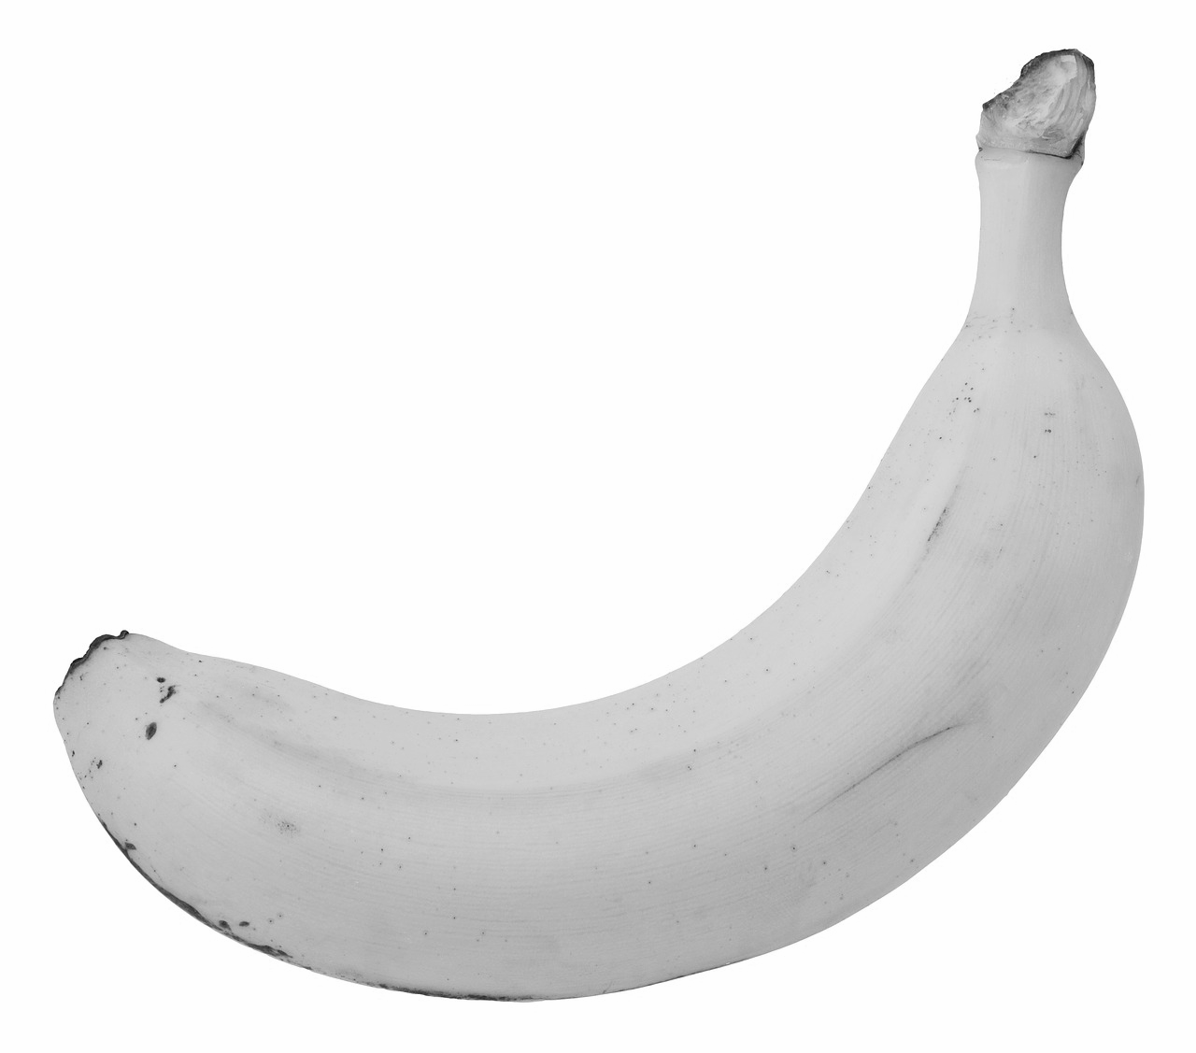
How many bananas?
Cross them out as you count them
Images from Pixabay
Notes:
Model a few times using different numbers to 5, showing on big screen putting bananas away in fruit bowl.

Slide 9
How many dots?
3
4
or

Slide 10
How many dots?
4
5
or

Slide 11
How many dots?
1
2
or

