Slide 1
Sequencing daily events
Mathematics
Miss Sabzvari

Slide 2
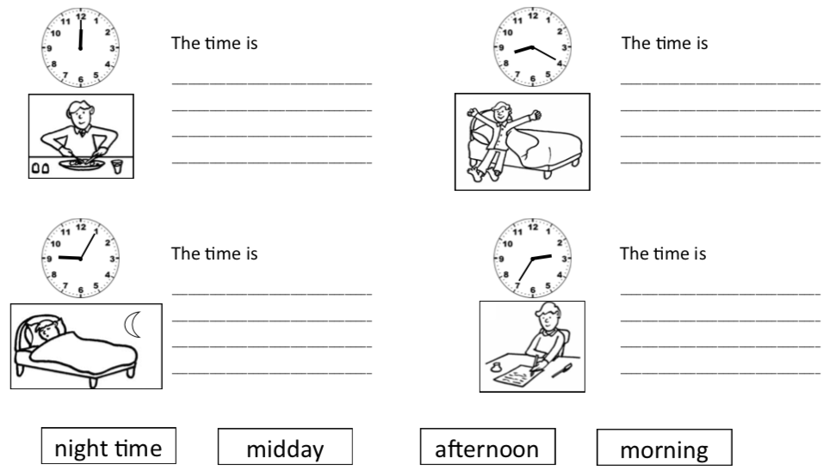
Independent Task
-Write the time for
each activity in words.
Remember to use one
of the words at the
bottom of the page.
-Number the activities in order.

