Slide 1
Biological Systems and Processes
Lesson 6 - The Effects of Exercise on Respiration
KS3 Biology
Miss Hindle

Slide 2
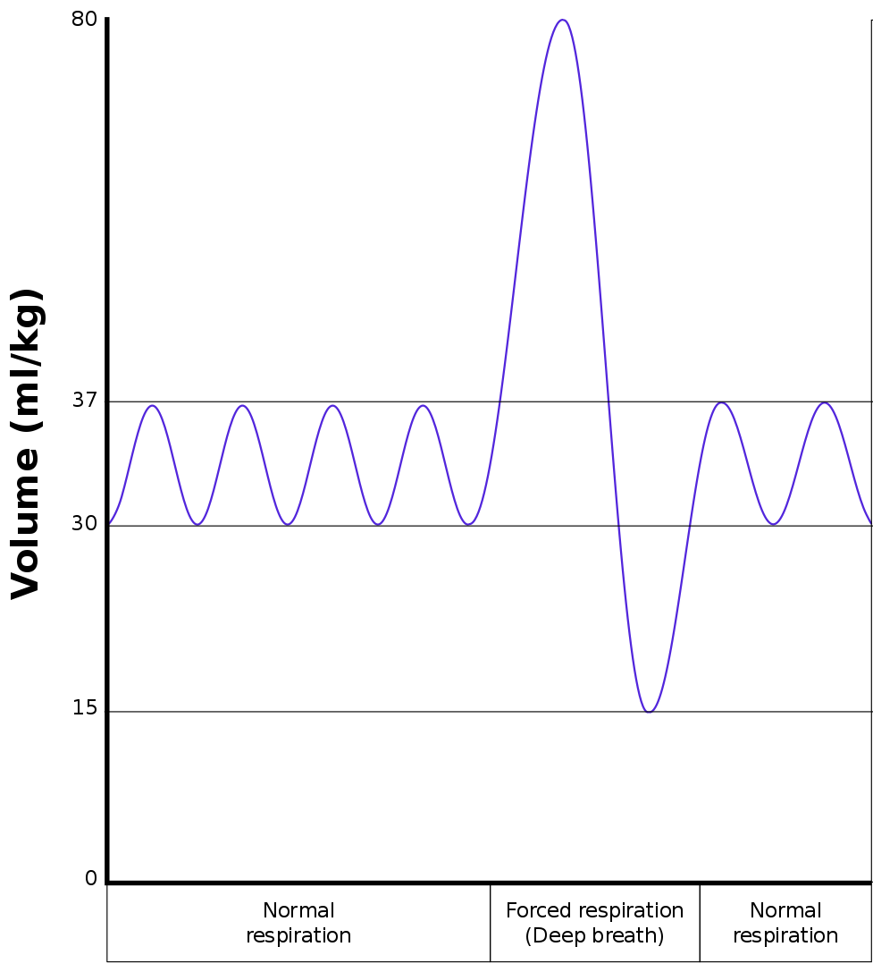
Breathing Rate
This is a spirometer trace.
What is the volume of air inhaled during a deep breath?
What is the volume of air inhaled in a single normal breath.
How many breaths did this person take whilst this spirometer was on?
What would the breathing rate of this person be if this was taken over 30 seconds?
Vihsadas at English Wikipedia., Creactive Commons, Wikimedia

Slide 3
Quick Quiz...
To carry out more respiration, what reactants will the body need more of?
How do these reactants get around the body?
When your heart beats faster what does this do to the blood?
What do you do to get more oxygen into your body?

Slide 4
Complete this summary:
During exercise your _________ rate and ___________ rate increase to get more _________ into the blood and then to muscle cells

Slide 5
Effects of exercise...
Condition | Description of change | Explanation
Heart rate
How hard the heart beats
Breathing rate
Breathing depth
Blood flow to muscles

Slide 6
Effects of exercise...
Condition | Description of change | Explanation
Heart rate | Heart rate increases / decreases | To pump more / less blood to the muscles to deliver more / less oxygen and glucose
How hard the heart beats | The heart beat harder / softer | To pump a larger / smaller volume of blood
Breathing rate | Breathing rate increases / decreases | To maintain concentration gradients and get more / less oxygen in and more / less carbon dioxide out
Breathing depth | Breathing depth increases / decrease | To maintain concentration gradients and get more / less oxygen in and more / less carbon dioxide out
Blood flow to muscles | Increases more / less the harder you exercise | Muscles need a bigger / smaller supply of oxygen and glucose so they can respire more / less and release more / less energy

Slide 7
Exam Style Question
Explain why the muscles need more blood flowing to them during exercise (4 marks)
………………………………………………………………………………………………………………………………………………………………………………………………………………………………………………………………………………………………………………………………………………………………………………………………………………………………………………………………………………………………………………………………………………………………………………………………………………………………………………………………………………………………………………………………………………………………………………………………………………………………

Slide 8
Exam Style Question
Explain why breathing rate is higher when running than it is walking (4 marks)
………………………………………………………………………………………………………………………………………………………………………………………………………………………………………………………………………………………………………………………………………………………………………………………………………………………………………………………………………………………………………………………………………………………………………………………………………………………………………………………………………………………………………………………………………………………………………………………………………………………………

