Slide 1
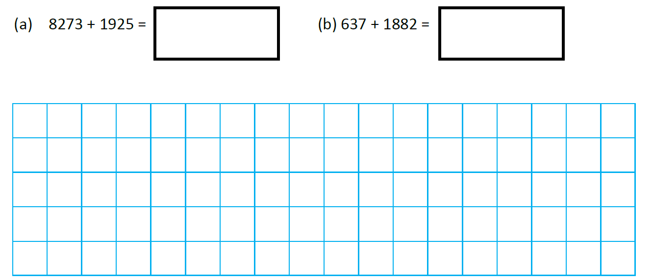
Independent Task
Addition
Use the column method to add the following amounts:

Slide 2
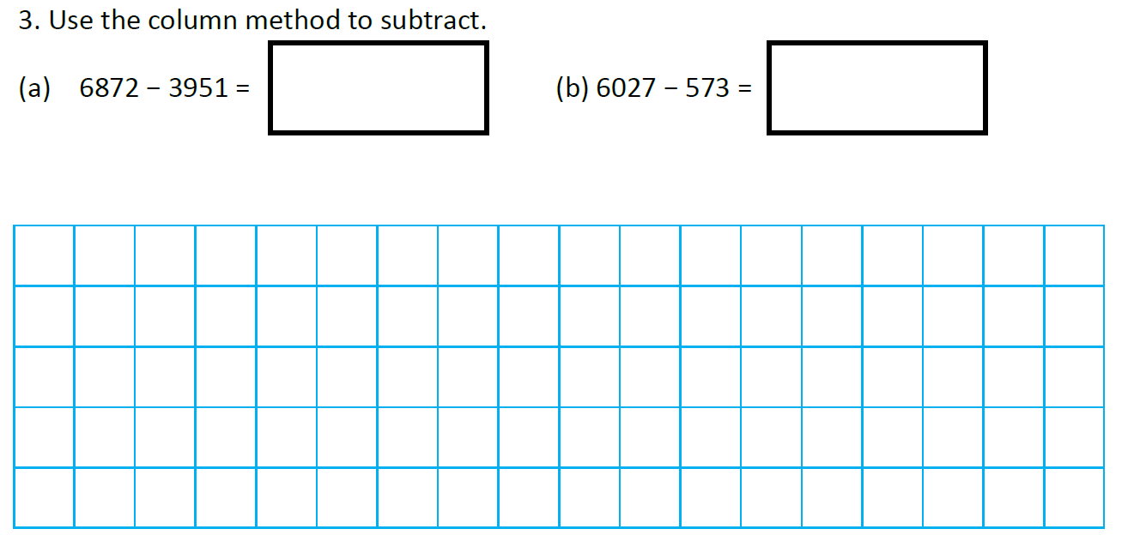
Independent Task
Subtraction
Use the column method to subtract the following amounts:

Slide 3
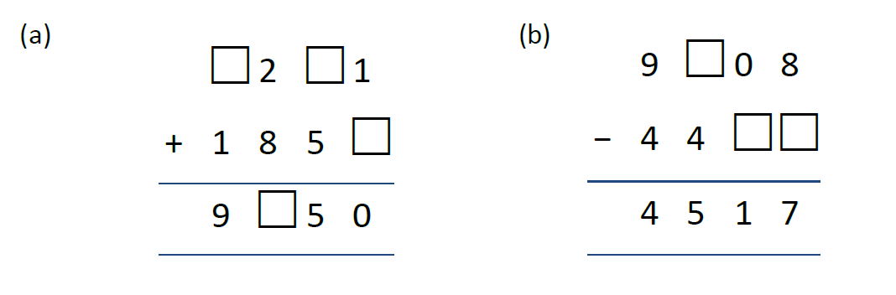
Independent Task
Missing numbers
Challenge: Complete the missing boxes!

