Slide 1
Talking about what you are doing now and were doing then (Part 2/2) Present vs Imperfect continuous
Content warning: Social media is only suitable for persons aged 13+
Spanish
Señorita Allinson

Slide 2
[rr]
correr
correo
perro
cerrar
correcto

Slide 3
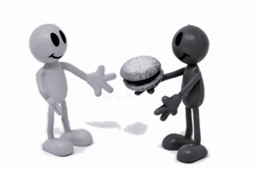
[r]
dar
abrir
pero
seria
caro

Slide 4
estar + present participle vs estar por + infinitive
Use estar + present participle for ongoing actions.
Use estar por + infinitive to mean be about to do something.
Note: the present participle means -ing, the infinitive means (to) do.
salir is the infinitive.
Compare:
Estoy por salir. =
Estoy saliendo. =
Compare:
Estaba por salir. =
Estaba saliendo =
I am about to go out.
I was about to go out.
I am going out.
I was going out.
saliendo is the present participle.

Slide 5
The imperfect continuous
Use the imperfect continuous to say what you ______ ________.
Use the imperfect of _________ + ________ __________.
To say ‘was just about to do something’ use the __________________ of estar + _______________.
Complete the jigsaw translation in Spanish and English: ________ esperando porque estaba ____ ________ en clase. I was ________ because _______ about to go into class.
You were about to go out but you were looking for your phone. . → Spanish = ________________________________________________
were
doing
estar
present participle
imperfect
infinitive
Estaba
por entrar
waiting
I was
Estabas por salir pero estabas buscando tu móvil.

