Slide 1
Highest common factor - downloadable resource.
Lesson 5 of 8.
Mathematics
Dr Rim Saada

Slide 2
1) List the factors of 32 and the factors of 48.
2) What factors do they have in common?

Slide 3
List all the common factors of 30 and 42.
What is the HCF of 30 and 42?
Find a different pair of numbers with the same HCF.
If the HCF of two numbers is 30 list all the common factors.

Slide 4
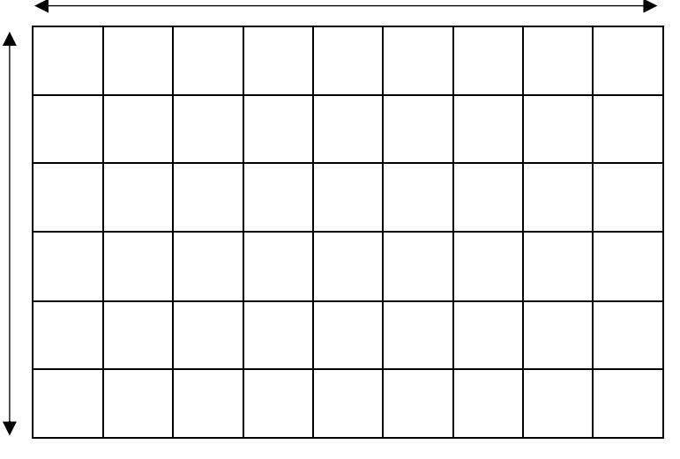
5) a) What size squares has this student split the rectangle in to?
b) What other squares size squares can you split it into?
54 cm
36 cm

Slide 5
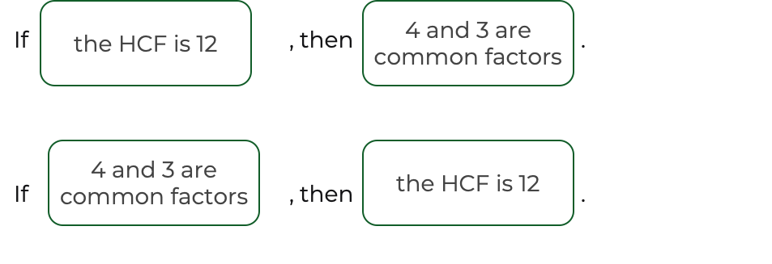
Decide if the following are always, sometimes or never true.
Notes:
Choose any two and explain how they represent the same maths

