Slide 1
To apply knowledge of number bonds
Independent Task
Maths
Mrs Bramble & Miss Sidhu
Notes:
Here is today’s independent task. I would like you to use the same concept as we’ve been doing with the gold and silver coins, only this time you have certain numbers you can use for gold and silver. Try and use the numbers in the gold and silver circles to complete the part-whole model.

Slide 2
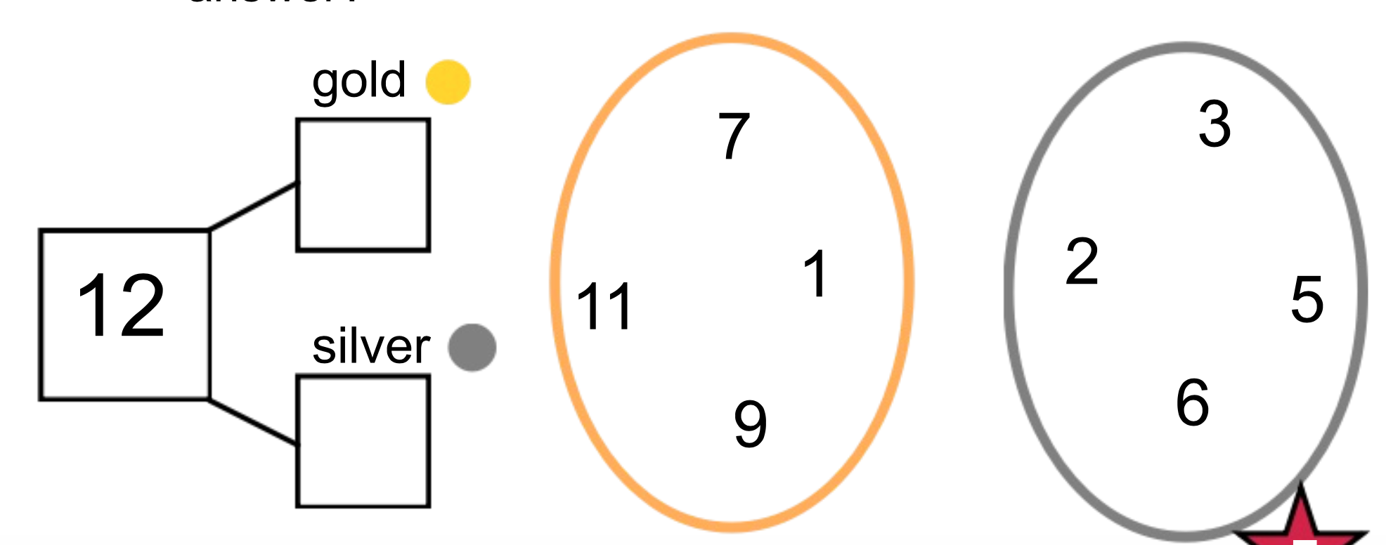
Independent Task
Task 1
Challenge: what if there were 24 coins in total? What are the different possibilities?
You can mix numbers from both circles, use numbers from the same circle and you can use numbers twice.
Notes:
Here is today’s independent task. I would like you to use the same concept as we’ve been doing with the gold and silver coins, only this time you have certain numbers you can use for gold and silver. Try and use the numbers in the gold and silver circles to complete the part-whole model.

Slide 3
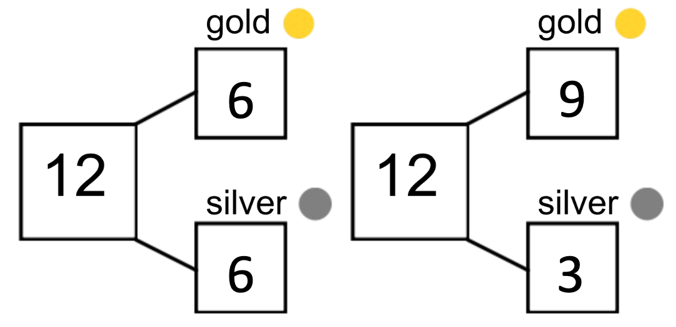
Answers
Task 1

Slide 4
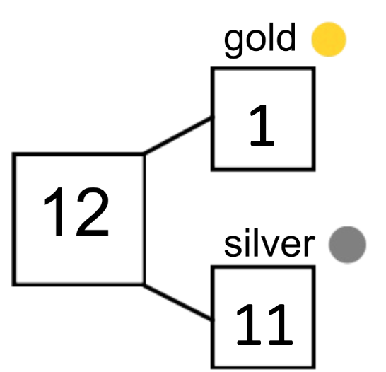
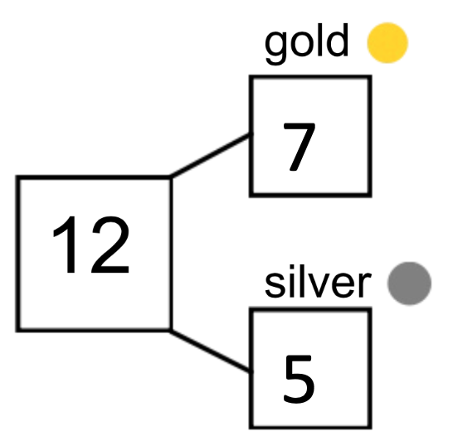
Answers
Task 1

