Slide 1
Talk about what you are doing today vs what you did yesterday [2/2]
Present vs past (perfect) tense: Regular -er verbs with ‘avoir’
French
Madame Johnson

Slide 2
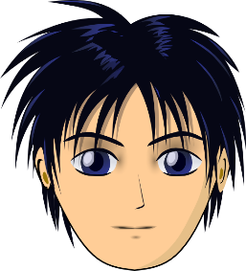
[ ê / è ]
tête

Slide 3
[ ê / è ]
fête
collège
frère

Slide 4
payer | to pay
le passé | past
la banque | bank
hier | yesterday
l’impôt | tax
corriger | to correct
utiliser | to use
maintenant | now

Slide 5
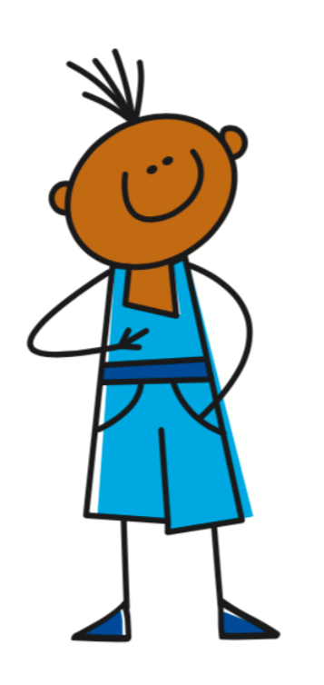
The perfect tense - a completed action in the past
We have already seen two irregular verbs
Past participle
Past participle
J’
ai
fait
J’
ai
dit
I did/I made
I said

Slide 6
The perfect tense - a completed action in the past
Regular -ER verbs
I visited / I have visited
I paid/ I have paid
Je
ai
visité
Je
ai
payé
J’
ai
visité
J’
ai
payé
Je visite = I visit
Je paie = I pay

Slide 7
The perfect tense
1. The Subject Pronoun
2. The Auxiliary Verb
(Avoir - Present Tense)
3. Past Participle
Je | ai | mangER - mangÉ
 |  | regardER - regardÉ
 |  | payER - payÉ
= I

Slide 8
visiter la banque
J’
ai
visité
la banque
I visited the bank

Slide 9
payer mon impôt
J’
ai
payé
mon impôt
I paid my tax

Slide 10
manger des escargots
ai
mangé
J’
des escargots
I ate some snails

Slide 11
jouer au beach-volley
ai
J’
joué
au beach-volley
I played beach volleyball

Slide 12
The Perfect Tense - The Auxiliary
1. | I visited = | J’___ visité
2. | I ate = | J’ __ mangé
3. | I paid = | J’___ payé
4. | I played = | J’ ___ joué
5. | I corrected = | J’___ corrigé
ai
ai
ai
ai
ai

Slide 13
Talk about what you are doing today vs what you did yesterday [2/2]
The perfect tense refers to a completed action in the...
2. To form it we need a pronoun, the auxiliary verb and a...
3. What do -er verbs usually end in in the perfect tense?
4. I played =
5. I corrected =
6. I did and I said =
past
past participle
-é
j’ai joué
j’ai corrigé
j’ai fait et j’ai dit

