Slide 1
Say what people have [2/2]
Avoir: singular
Position of adjectives with nouns
French
Madame Sooden

Slide 2
[ i ]
midi

Slide 3
[ i ]
ici
qui ?
il

Slide 4
[ eu ]
deux

Slide 5
[ eu ]
un peu
jeu
[a little]
lieux
[place]

Slide 6
une chambre | a room
une voiture | a car
un animal | a pet
un chien | a dog
un ordinateur | a computer
un portable | a mobile phone
un vélo | a bike
rapide | fast
cher, chère | expensive
moderne | modern

Slide 7
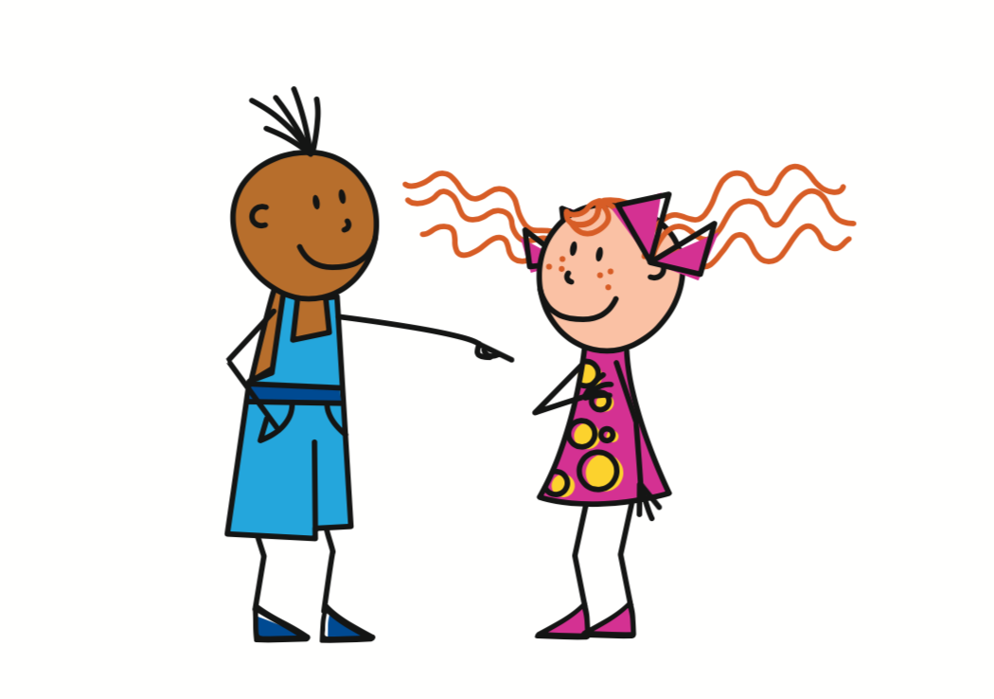
Avoir
- to have
J’ai
= I have
Tu as
= You have
To refer to yourself
To refer to another specific person

Slide 8
Avoir
- to have
= He has
Elle a
= She has
Il a
To refer to a singular male
To refer to a singular female

Slide 9
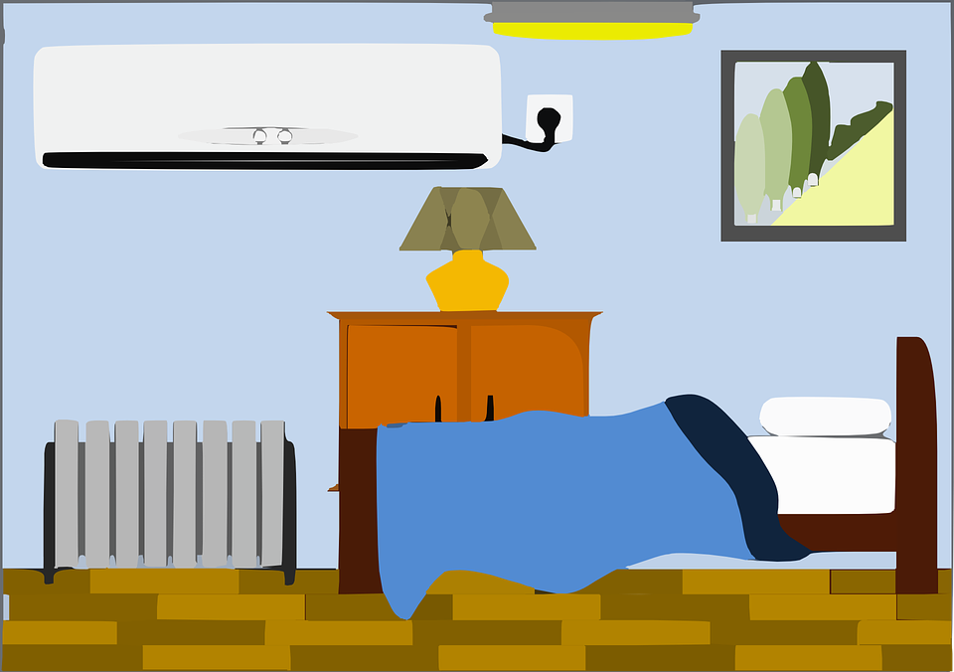
Avoir
- to have
Use avoir with a noun to say what people have.
Il a un chien
Elle a une chambre
He has a dog
She has a bedroom

Slide 10
Indefinite articles
In English we have the indefinite article a.
In French, you choose from un and une.
This depends on whether the noun is masculine or feminine.
 | Masculine | Feminine
Indefinite a | un | une

Slide 11
French adjectives with nouns
Position=
Before noun
une belle maison
a beautiful house
Position=
After noun
un vélo rapide
a fast bike
Pre-nominal adjectives
Post-nominal adjectives
Clue:
Pre
Clue:
Post

Slide 12
Réponse
J’ai un animal moderne.
2. J’ai un chien rapide.
3. Tu as un portable cher.
4. Il a un ordinateur rapide.
5. Elle a une chambre chère.
I have a modern pet.
I have a fast dog.
You have an expensive mobile.
He has a fast computer.
She has an expensive bedroom.

Slide 13
Say what people have
1 | What is the verb ‘to have’ in French?
2 | ‘She has’ in French
3 | ‘He has’ in French
4 | Position of post-nominal adjective
5 | ‘Fast’ in French
6 | Expensive can be ‘cher’ or ‘chère’, why?
avoir
elle a
il a
after the noun
rapide
masc / feminine

