Slide 1
Describing a town [1 / 3]
Using on peut and on ne peut pas
French
Monsieur Lowe

Slide 2
Phonétique

Slide 3
[ qu ]
?
question

Slide 4
[ qu ]
quatre
manquer
[to miss, be missing]
musique

Slide 5
la banlieue | suburb
le quartier | district/area.
les espaces verts | green spaces
l’aire de jeux | playground
la zone piétonne | pedestrian area
le magasin | shop
voir | to see
visiter | to visit (a place)
aller | to go
faire | to do

Slide 6
Grammaire Using on peut and on ne peut pas

Slide 7
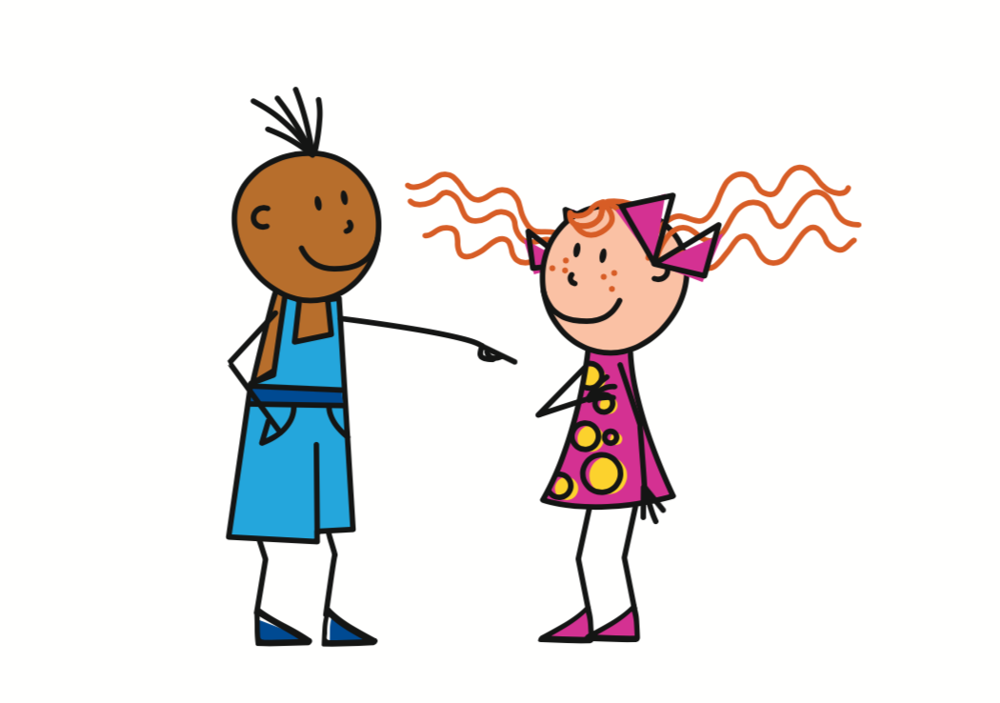
On
- You, we
= You
Tu
On
= You, we
To refer to one specific person
Vous
= You
To refer to a group of specific people
To refer to people in general

Slide 8
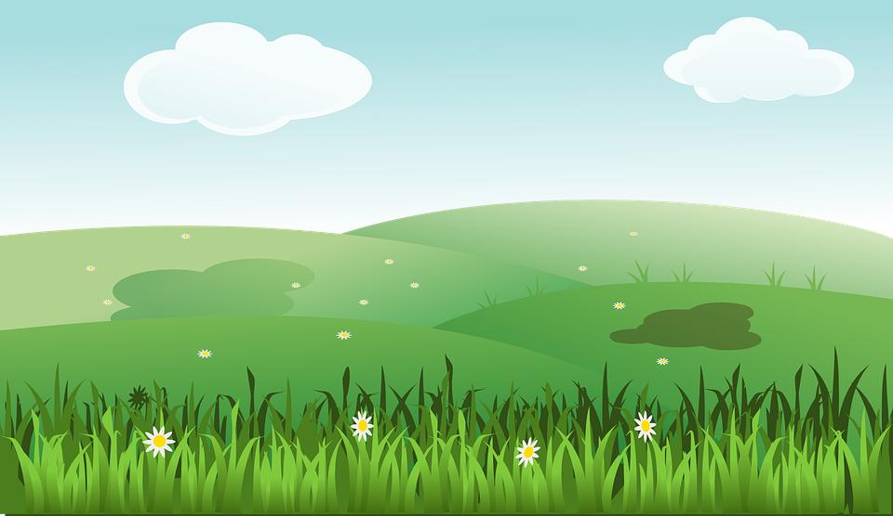
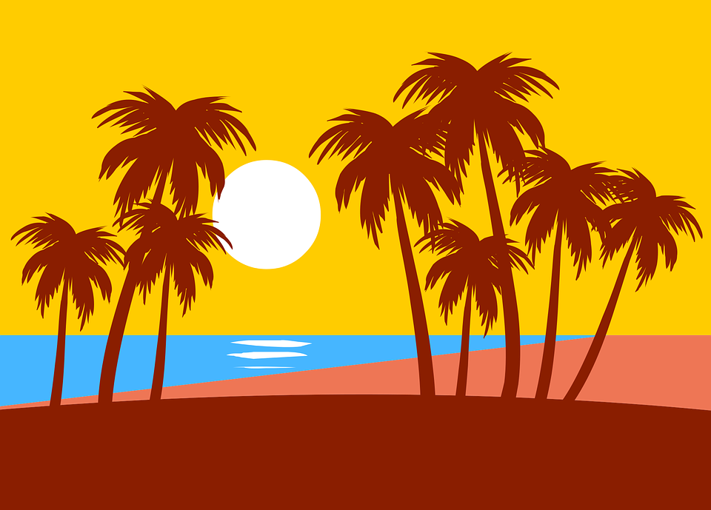
On peut
You can
On peut is followed by an infinitive phrase. Infinitives are the form of the verb ending in -ER, -IR or -RE.
On peut visiter les espaces verts = You can visit green spaces
On peut aller à la plage =
You can go to the beach

Slide 9
On ne peut pas
Translates as You cannot
On ne peut pas - the negative ‘ne … pas’ goes around the verb and then the infinitive phrase follows.
On ne peut pas voir le musée = You cannot see the museum
On ne peut pas faire du shopping = You cannot go shopping

Slide 10
Describing a town
Infinitives end in =
On peut means =
On ne peut pas means =
Ne … pas goes =
Visiter les monuments =
To go shopping =
-ER, -IR and -RE
you/we can
you/we cannot
around the verb
To visit the monuments
faire du shopping

Slide 11
Share your work with Oak National
If you'd like to, please ask your parent or carer to share your work on Instagram, Facebook or Twitter tagging @OakNational and #LearnwithOak

