Slide 1
Commutativity between multiplication and division
Maths
Miss Brinkworth

Slide 2
Draw representations of the facts below.
5 x 2 = 10
1 x 6 =
3 x 3 =
(Challenge - What other facts can you derive from them?)
Match the facts.
5 x 7 = 35
2 x 9 = 18
24 6 = 4
18 9 = 2
4 x 6 = 24
35 5 = 7

Slide 3
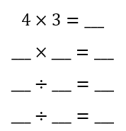
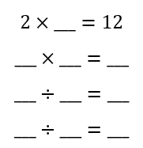
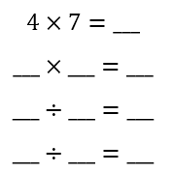
Part B -
fill in the gaps (use the arrays to help if you are stuck)
1.
2.
3.

Slide 4
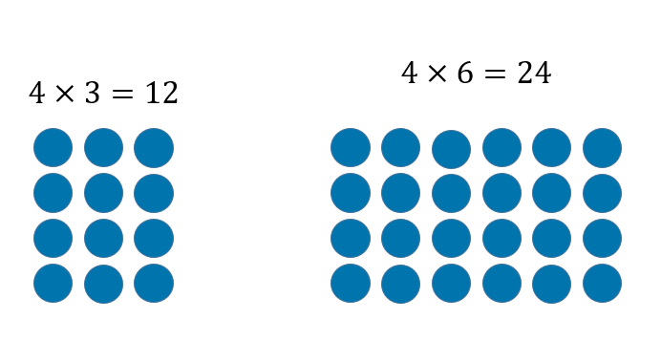
Part C
What is the same? What is different?
If you know that 11 x 5 = 55 what else do you know?

