Slide 1
Constructing Quadrilaterals
Downloadable Resource
Mathematics
Miss Oreyomi
Miss Oreyomi

Slide 2
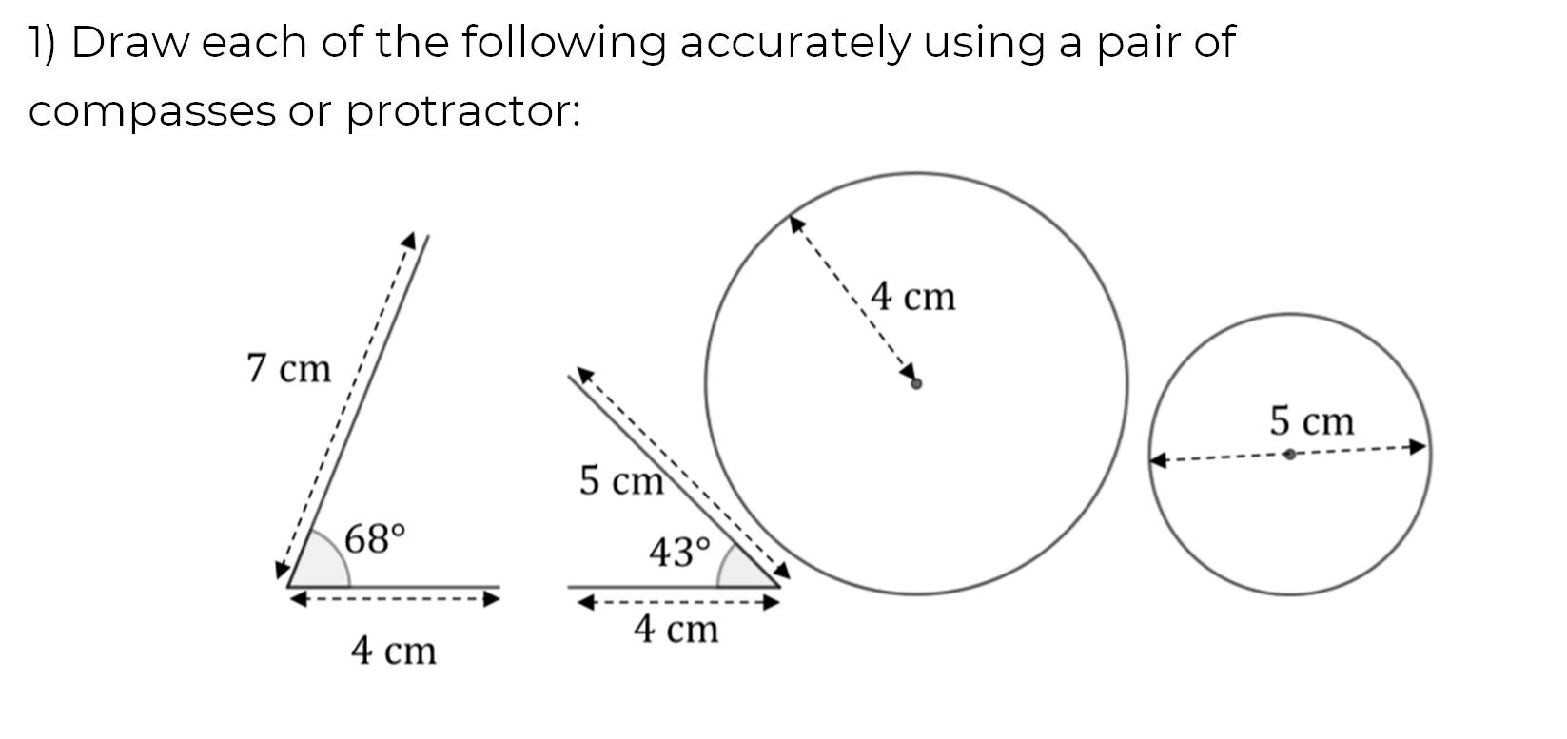
Questions

Slide 3
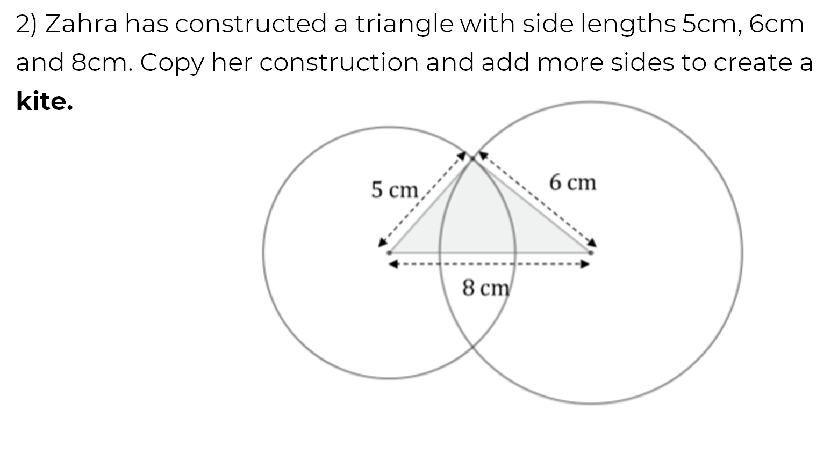
Questions

Slide 4
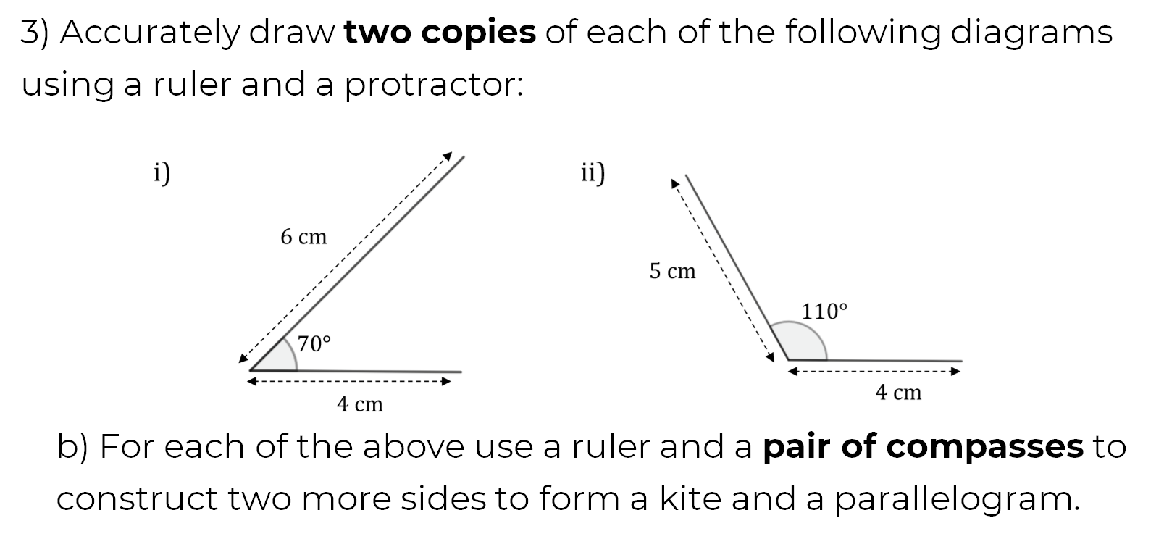
Questions

Slide 5
Questions

