Slide 1
Finding the HCF
Maths
Mr Lund

Slide 2
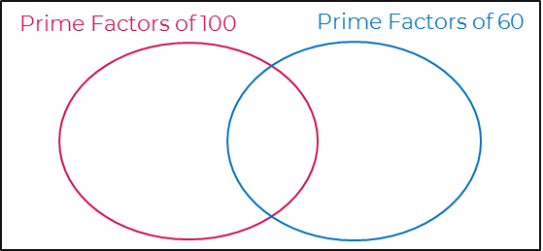
Finding the HCF
1. Troy is writing 40 as a product of its prime factors. He draws a factor tree to help him.
Complete the factor tree for 40
Write 40 as a product of its prime factors.
2. a) Write 100 as a product of its prime factors.
b) Write 60 as a product of its prime factors.
c) Complete the Venn diagram.
d) Work out highest common factor (HCF) of 100 and 60
40
5
8
4
2

Slide 3
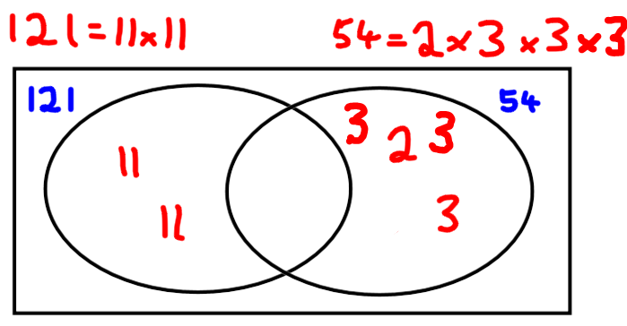
Finding the HCF
3. Work out the HCF of each of the following pairs of numbers
45 and 60
48 and 72
120 and 150
90 and 72
180 and 96
4. Tom wants to find the HCF of 121
and 54
He writes each number as the product of its prime factors and draws a Venn diagram.
What is the HCF of 121 and 54?

Slide 4
Answers

Slide 5
Finding the HCF
1. Troy is writing 40 as a product of its prime factors. He draws a factor tree to help him.
Complete the factor tree for 40
Write 40 as a product of its prime factors.
2. a) Write 100 as a product of its prime factors.
b) Write 60 as a product of its prime factors.
c) Complete the Venn diagram.
d) Work out highest common factor (HCF) of 100 and 60
= 2 x 2 x 5 x 5 = 2² x 5²
40
= 2 x 2 x 3 x 5 = 2² x 3 x 5
5
8
4
2
5
2
5
3
2
2
2
40 = 2³ x 5
20

Slide 6
Finding the HCF
3. Work out the HCF of each of the following pairs of numbers
45 and 60
48 and 72
120 and 150
90 and 72
180 and 96
4. Tom wants to find the HCF of 121
and 54
He writes each number as the product of its prime factors and draws a Venn diagram.
What is the HCF of 121 and 54?
15
24
30
18
12
1

