Slide 1
To classify triangles
Worksheet
Maths
Miss Miles

Slide 2
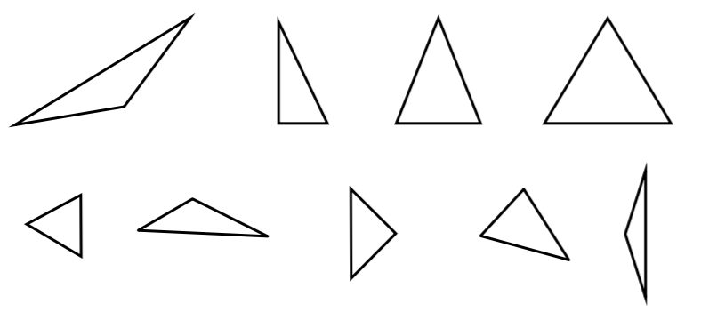
Independent Task
 | Equilateral | Isosceles | Scalene
All angles are acute
Has one right angle
Has one obtuse angle
Task
Sort the triangles into the correct place in the sorting table.
1 2 3 4
5 6 7 8 9

