Slide 1
How do you compose a rap?
A number of activities in this download require you to listen to audio clips - these are given in the lesson worksheet
Music
Miss Charatan

Slide 2
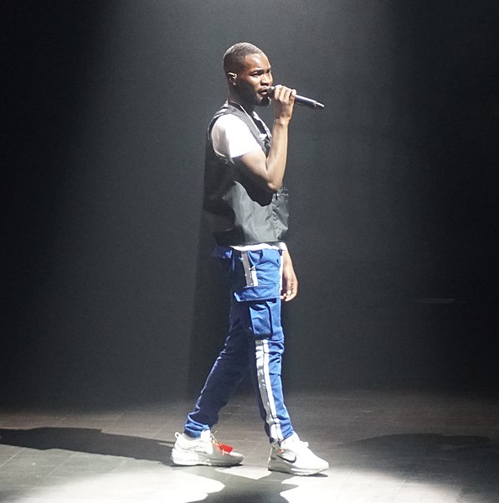
What is rap?
Listen to ‘Black’ by Dave in the lesson video and answer these questions.
What is Dave rapping about?
What do you think rap is?
Notes:
Stretch: do you listen to rap?
Naomi to speak

Slide 3
Step 1: Deciding your message/point, choosing your topic
Your family
Gaming
Music
Fashion
Your heritage
Movies
Football/sport
Your manor
Social media
The environment
Skating/boarding
Racism
Gender inequality
Coding/programming
Notes:
Kenny to speak

Slide 4
Example topic A:
your family
Example topic B:
football
Example topic C:
your manor
Possible question: What are some things that different members of your family told and taught you?
Voice considerations: Will you be speaking/writing as the family member? Or as yourself? Or both?
Possible question: Who would be the 11 players that make up your fantasy league team? And why?
Voice considerations: Are you speaking/writing as a new owner? The manager? A sports reporter?
Possible question: If you had 10 million to improve your neighbourhood, what changes would you make and why?
Voice considerations: Are you speaking/writing as a MP who has received a grant? Or as a someone from the manor who has made it big and is now giving back to the community?
Notes:
Kenny to speak

Slide 5
Example topic: racism
Example question: How can we cure racism?
Example to consider: written as a doctor in racism treatment.
Example Mind map: race, discrimination, prejudice, ignorance, the media, movies, criminals, colour, black, white, illness, disease, virus, cause, symptoms, cure, vaccine, medicine, immigrants, hate crimes, symptoms, friends, family, Trump, Nazis, skinheads, National Front, Black Lives Matter, All Lives Matter, diagnosis, cause, genetic, police brutality, prison, Africa, Europe, slavery, fear, hate, love…
Notes:
Kenny to speak

Slide 6
How to write a verse
Use your mind map, your word bank or colour palette.
Ask one of the 5Ws.
Who? What? Where? When? Why?...and how?
Answering that one word question will help you to extend, continue, follow each idea to its topical conclusion (the end of the thought).
Implement listing, ie- give/list at least 3 examples in explaining or describing.
Use opposites: up the stairs, then down the hall… chaos outside, find peace within… think global, act local…
Notes:
Kenny to speak

Slide 7
Example verse
Racism’s a disease
a virus to be sure
to first know its causes
before finding the cure…
For some, the cause is hate
For others, it’s just ignorance
some learn it off of their family
or an isolated incident
word from the mind map
what are some of the causes? (5 Ws)
eg. of listing
eg. of alliteration
Fearing the unknown
Hating what they don’t understand
Instead of braving the elements
And loving their fellow man
Need to start to look at the symptoms
If looking to find the cure…
eg. of opposites
what are some of the symptoms? (5 Ws)
Notes:
Kenny to speak

Slide 8
How long is a verse? How long is a bar?
A bar in a rap is the same as a bar in music.
Most raps are in , meaning 4 beats in a bar. Many raps use 16 bar verses.
In terms of lyrics, a bar could be one line, or more lines - depending on how quickly the words are being said, and how long the lines are!
4
4
1 2
Racism’s a disease
a virus to be sure
to first know its causes
before finding the cure…
3 4
This example is two groups of 4 beats, so it would be 2 bars. To make 16 bars, you will probably need to write 16 lines (32 short lines like this)
1 2
3 4
Notes:
Naomi to speak

Slide 9
How do we perform a rap?
Watch the video of Kenny’s performance in the lesson video and answer the following questions:
What does he do to add expression to his words?
How is his performance engaging?
What do you think he did to prepare?

Slide 10
References
Slide [2] - [Wikimedia Commons] - [SamuelWren98] - [Santan Dave]

