Slide 1
Lesson 1: Exploring Conditions
Selection in Quizzes
Computing
Josh Crossman
Materials from the Teach Computing Curriculum created by the National Centre for Computing Education

Slide 2
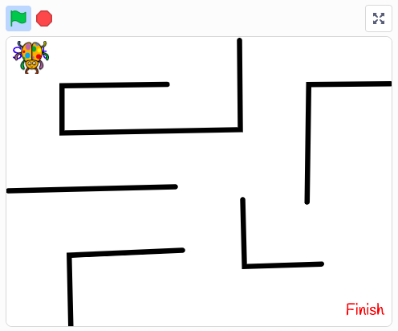
Task 1 - Using selection
Open ncce.io/p5b1-1
Look at the code snippets.
What selection is taking place?
What conditions are being carried out?
What actions are being carried out if the conditions are true?
Credit: Scratch

Slide 3
Task 2 - Conditions in programs
Open ncce.io/p5b1-2
Run the program and explore how the conditions have been used for each code snippet.
Record your findings for each code snippet using the table structure on the next slide.

Slide 4
Task 2 - Conditions in programs
 | What is the condition? | What happens when the condition is true?
A
B
C

Slide 5
Task 3 - Modifying conditions
Open ncce.io/p5b1-3
Change the condition for both code snippets.
Run the program to check that the action is carried out when the new condition is true.

