Slide 1
Say what people have [1 / 2]
Avoir: singular
Gender of indefinite articles
French
Madame Sooden

Slide 2
[ i ]
midi

Slide 3
[ i ]
ici
qui ?
il

Slide 4
[ eu ]
deux

Slide 5
[ eu ]
un peu
jeu
[a little]
lieux
[place]

Slide 6
une chambre | a room
une voiture | a car
un animal | a pet
un chien | a dog
un ordinateur | a computer
un portable | a mobile phone
un vélo | a bike

Slide 7
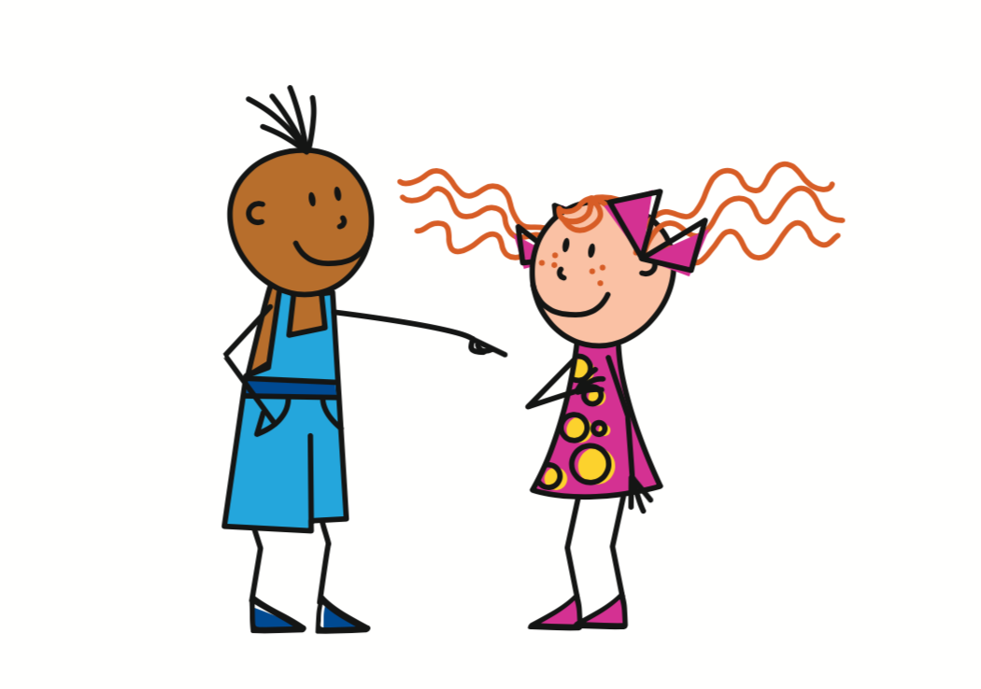
Avoir
- to have
J’ai
= I have
Tu as
= You have
To refer to yourself
To refer to another specific person

Slide 8
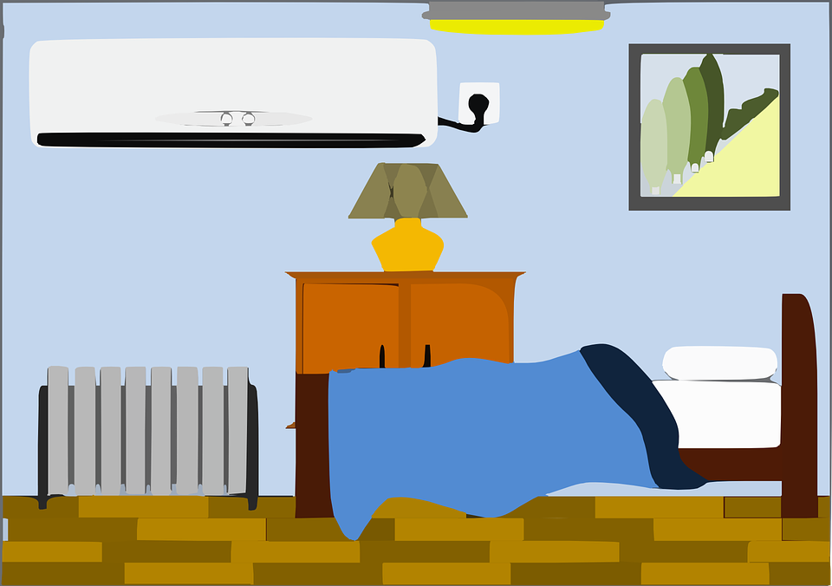
Avoir
- to have
Use avoir with a noun to say what people have.
J’ai un chien
Tu as une chambre
I have a dog
You have a bedroom

Slide 9
avoir ou être?
 |  | Avoir | Être
1. | Je suis anglaise.
2. | J’ai un portable.
3. | Tu es triste.
4. | Tu as un vélo.
5. | J’ai une voiture.

Slide 10
Indefinite articles
 | Masculine | Feminine | Plural
Definite the | le | la | les
Indefinite a | un | une

Slide 11
Indefinite articles
In English we have the indefinite article a.
In French, you choose from un and une.
This depends on whether the noun is masculine or feminine.
 | Masculine | Feminine
Indefinite a | un | une

Slide 12
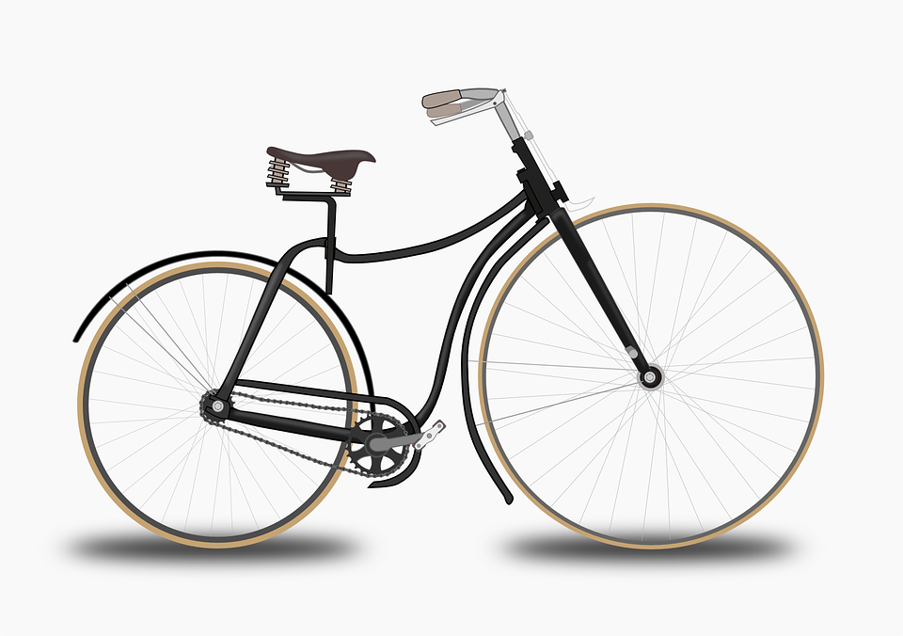
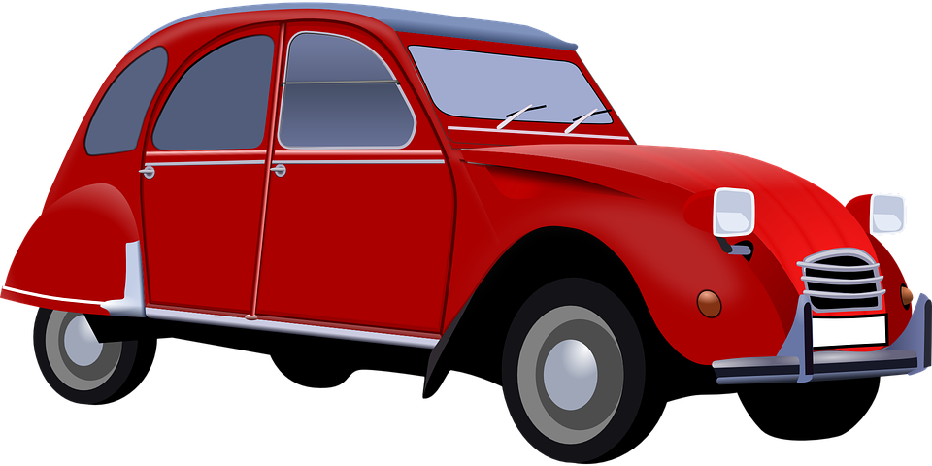
Reading Practice - j’ ou tu
 |  | Blank | Picture | English
1 | _____ ai un chien.
2 | _____ as un ordinateur.
3 | _____ as une chambre.
4 | _____ ai une voiture
5 | _____ ai un vélo.
J’
C
I have a dog
Tu
D
You have a computer
Tu
E
You have a bedroom
J’
B
I have a car
J’
A
I have a bike
A
B
C
D
E

Slide 13
Say what people have
1 | The verb avoir means?
2 | ‘I have’ in French
3 | ‘You have’ in French
4 | ‘A computer’ in French
5 | Name two indefinite articles
6 | Does you voice change for questions?
to have
j’ai
tu as
un ordinateur
un / une
goes up

