Slide 1
Rotational Symmetry
Independent Task
Mathematics
Miss Oreyomi

Slide 2
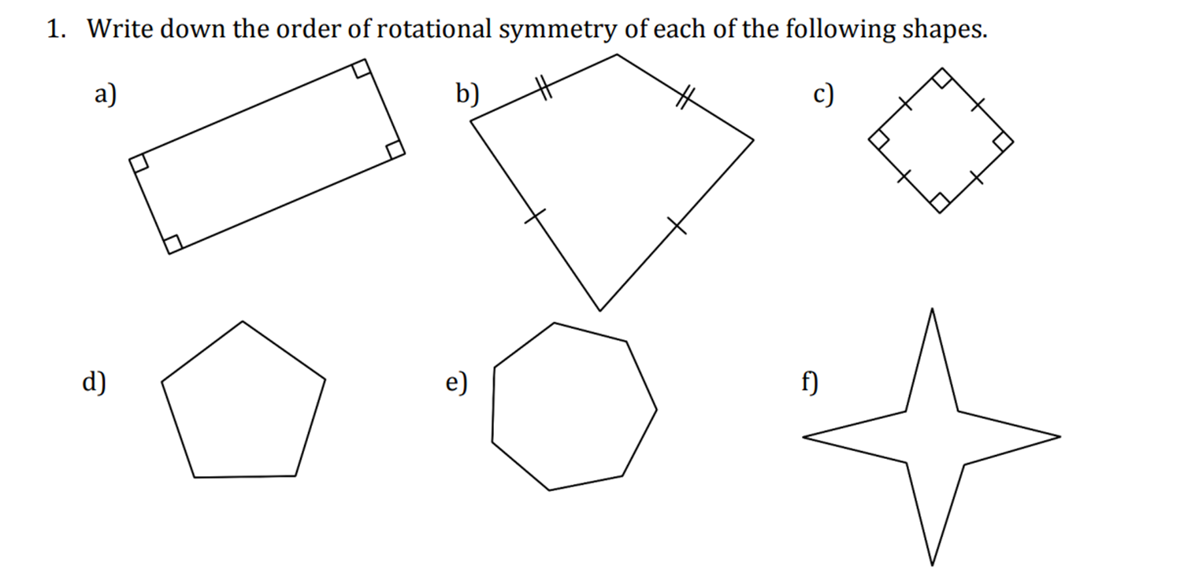
Questions

Slide 3
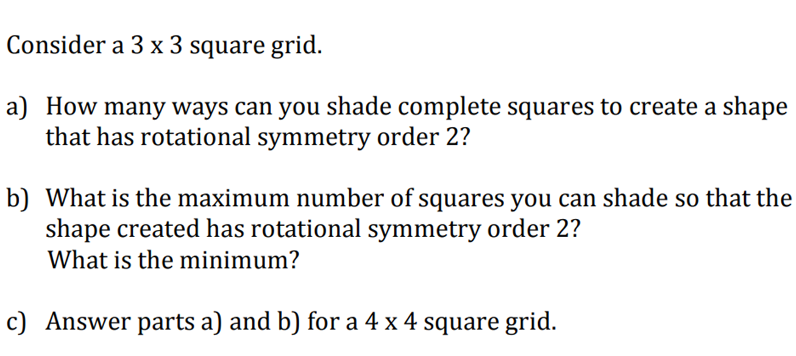
Questions

