Slide 1
Decimals and measures
Solve problems involving the calculation and conversion of units of area
Independent Task
Mathematics

Slide 2
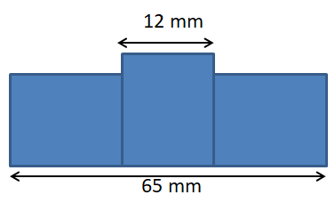
Question 1
Three identical rectangles have been used to form
this compound rectilinear figure.
Calculate the area of the figure.
Write the area in cm².

Slide 3
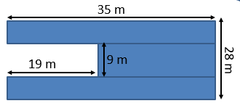
Question 2
The diagram shows a plan of a new zone at the Space Centre.
Calculate the area of the new zone in cm².

Slide 4
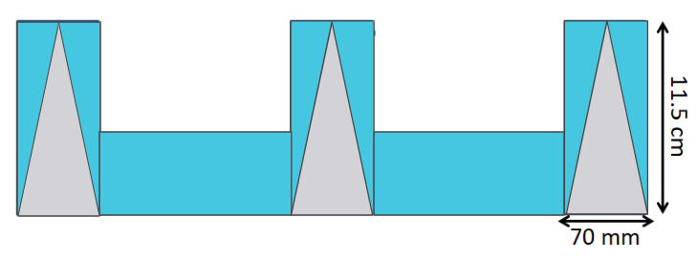
Question 3
Liman creates a design using 5 identical rectangles.
He cuts three identical isosceles triangles from his design.
What is the total of the grey removed from the design? Give your answer in mm².
What is the total of the blue area of Liman’s design in cm²?

