Slide 1
Unit 8: Decimals
Multiplying and Dividing by 100
Independent Task
Mathematics
Lesson 15 of 15
Mr Whitehead

Slide 2
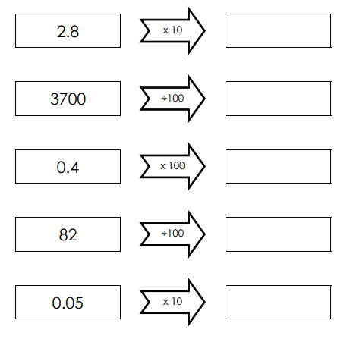
Complete the function machines
0.82
0.5

Slide 3
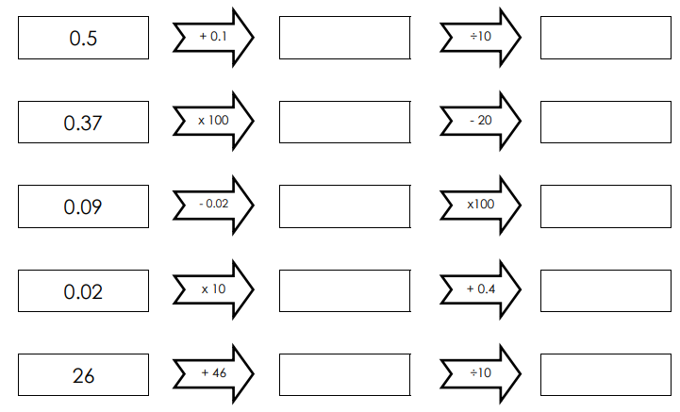
Complete the function machines
0.2
0.6
72
7.2

