Slide 1
Angles
Downloadable Resource – Partitioning angles.
Mathematics
Mr. Thomas

Slide 2
Try this
A
B
Use the information below to sketch similar diagrams for a selection of the factor pairs.

Slide 3
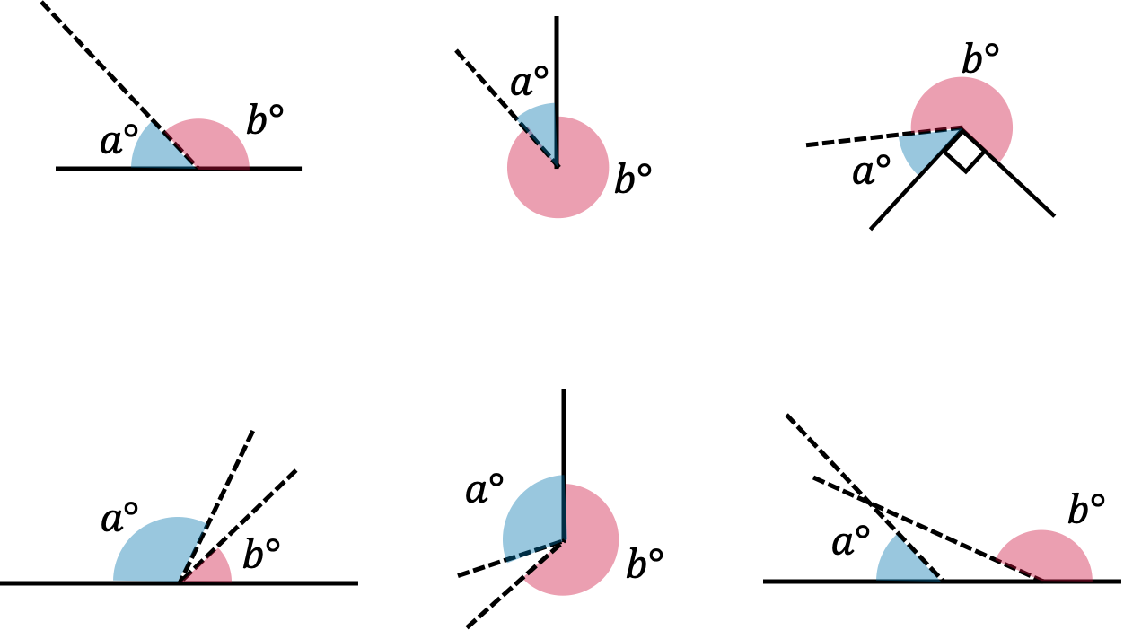
Connect What equations can we form about the given angles here? How about some inequalities for the latter questions?

Slide 4
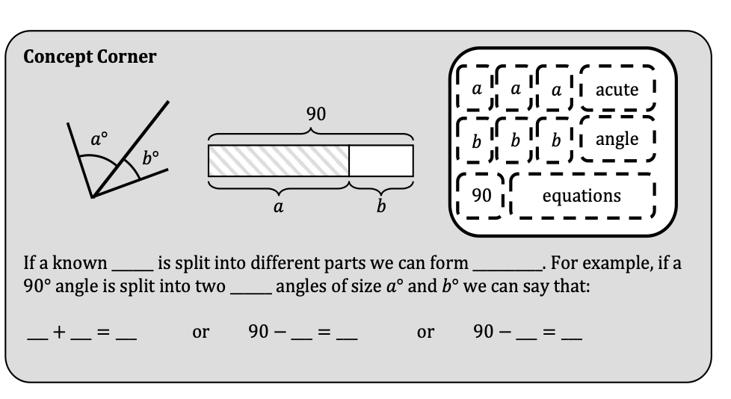
Fill in the blanks for the following exercise. You may want to go back in the video for some help.
Independent Task

Slide 5
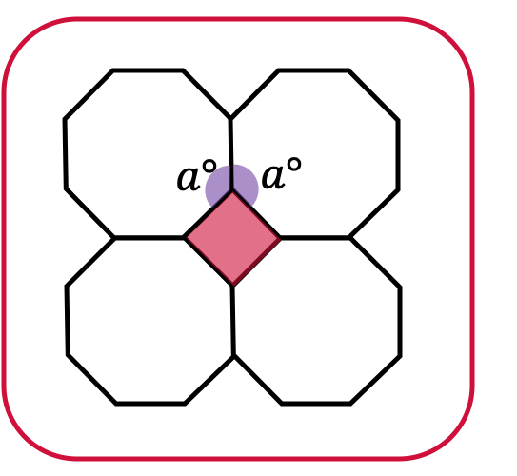
Can you form two equations, using two different angle facts, to solve a?
Explore

