Slide 1
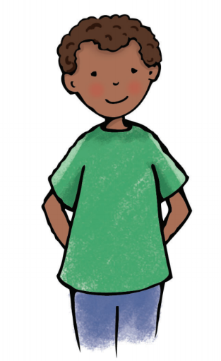
Independent Task
Target: Greatest number
Mrs Crane
Jeremy
Using your dice, roll to make your digit cards and see if you can beat Mrs Crane and Jeremy in each round.
Remember, check the target you are aiming for!
4 | 3
1 | 6
2 | 4
3 | 3

Slide 2
Independent Task
Target: Smallest number
Mrs Crane
Jeremy
Using your dice, roll to make your digit cards and see if you can beat Mrs Crane and Jeremy in each round.
Remember, check the target you are aiming for!
1 | 4
4 | 6
5 | 3
6 | 2

Slide 3
Independent Task
Target: Closest to 3000
Mrs Crane
Jeremy
Using your dice, roll to make your digit cards and see if you can beat Mrs Crane and Jeremy in each round.
Remember, check the target you are aiming for!
1 | 6
2 | 4
4 | 2
5 | 5

Slide 4
Independent Task
Target: Closest to 5000
Mrs Crane
Jeremy
Using your dice, roll to make your digit cards and see if you can beat Mrs Crane and Jeremy in each round.
Remember, check the target you are aiming for!
2 | 5
1 | 4
4 | 6
2 | 1

