Slide 1
Speed as rate (Distance-time graphs) Lesson 5 of 8
Downloadable resource
Mathematics
Miss Kidd-Rossiter

Slide 2
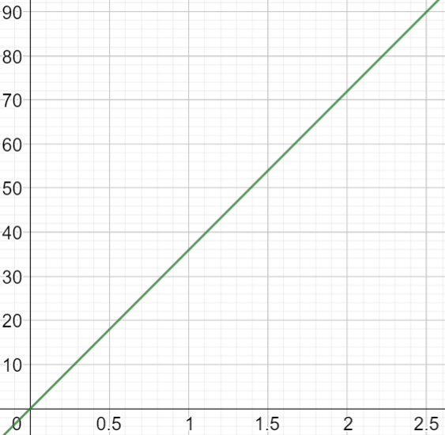
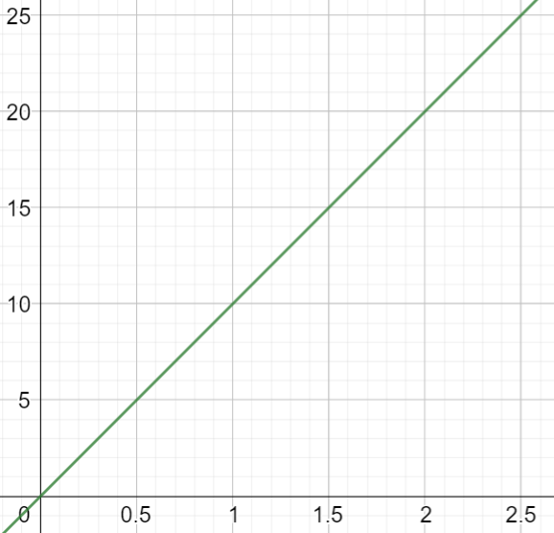
What’s the same about what these graphs show? What’s different?
distance travelled (kilometres)
distance travelled (metres)
time (hours)
time (seconds)

Slide 3
We can think of speeds as distance per unit of time.
distance travelled (kilometres)
time (hours)

Slide 4
A car is travelling at 30 kilometres per hour. How far will the car travel in:
30 minutes
3 hours
One and a half hours
3 hours and 45 minutes

Slide 5
How can you describe the speed in each of these statements?
Binh walks 1 mile in 20 minutes
Cala cycles 54 km in 3 hours.
Xavier swims 150 m in 6 minutes
Zaki runs 14 km in 2 hours
Hint: we can think of speeds as distance per unit of time

Slide 6
Who is going faster? Antoni or Yasmin?
We are travelling 60 km in 2.5 hrs.
Yasmin
Antoni
We are travelling 100km in 4.5 hrs.

Slide 7
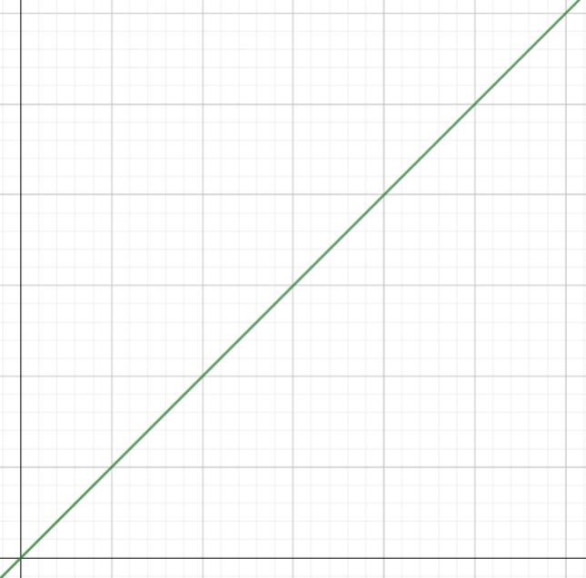
The graphs below show a car travelling at the same speed.
Complete the boxes three different ways.
5 miles = 8 kilometres
distance travelled (kilometres)
distance travelled (miles)
time (hours)
time (hours)

