Slide 1
Multiply powers
Maths
Mr Clasper

Slide 2
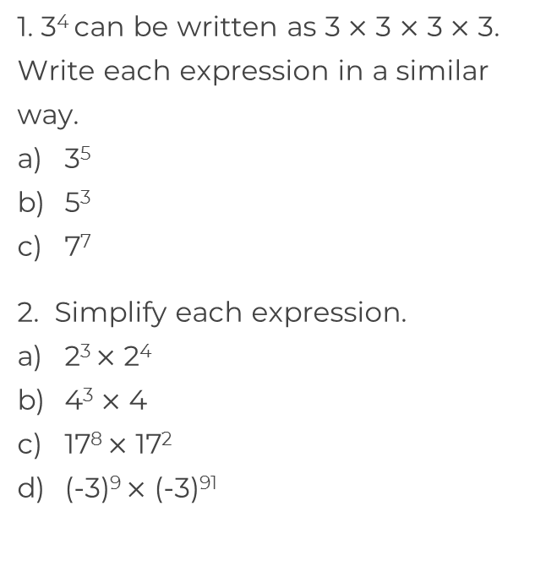
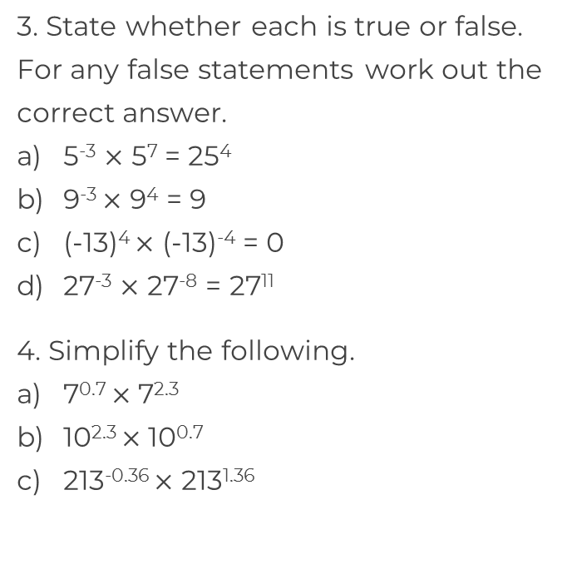
Multiply powers

Slide 3
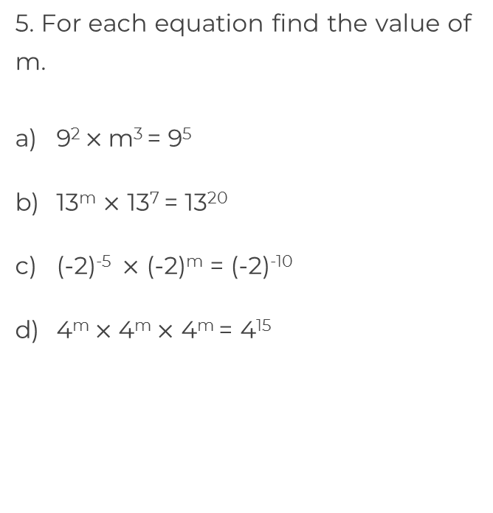
Multiply powers
7. A square has a side length of 9⁵ mm. Calculate the area of the square. Give your answer as a power of 9
9⁵ mm

Slide 4
Answers

Slide 5
Multiply powers
False. 5⁴
True
False. (-13)⁰ = 1
False. 27⁻¹¹
2⁷
4⁴
7³
17¹⁰
10³
(-3)¹⁰⁰
213¹ = 213

Slide 6
Multiply powers
7. A square has a side length of 9⁵ mm. Calculate the area of the square. Give your answer as a power of 9
m = 9
9⁵ mm
m = 13
m = -5
m = 5
9¹⁰ mm²

