Slide 1
Combined science - Physics - Key stage 4 - Particle Model of Matter
Gas pressure and volume - part 1
Worksheet
Mr Charman
Mr Charman

Slide 2
Exam question

Slide 3
Exam questions
A syringe contains air. The piston is pushed inwards. How does the pressure and volume of the air in the syringe change?
OCR, Gateway Physics A, Paper J249/01, Specimen.

Slide 4
Exam questions
2. These statements are about pressure and volume of a gas.
Which statement is correct?
A Volume doubles, pressure doubles
B Volume doubles, pressure halves
C Volume halves, pressure halves
D Volume halves, pressure stays constant
OCR, Gateway Physics A, Paper J249/01, June 2018.

Slide 5
Exam questions
OCR, 21st Century B, Paper J259/01, June 2019.
3. Hospitals store oxygen at high pressure in metal cylinders. The pictures show two cylinders, A and B. Both cylinders contain the same mass of gas and have the same temperature.
Cylinder B has a larger volume than cylinder A.
The pressure in cylinder B is smaller than the pressure in cylinder A.
Explain, using ideas about particles, why storing the same mass of gas in a larger volume produces a smaller pressure.
D Volum
OCR, Gateway Physics A, Paper J249/01, June 2018.

Slide 6
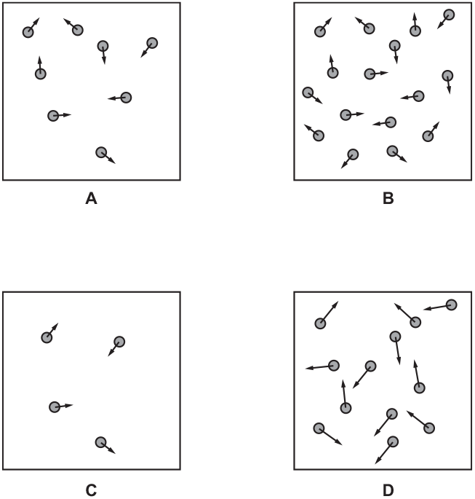
Exam questions
OCR, 21st Century B, Paper J259/02, June 2018.
4. This question is about the particles in a gas and the pressure they exert on a container.The diagram below shows four samples of the same gas in containers of the same size.
Each particle is shown as a circle.
The arrow on each particle shows its velocity.
Answer each question with one of the letters A, B, C or D.
i. Which sample has the fastest particles?
ii. Which sample has the greatest density?
iii. Which sample is at the highest temperature?
iv. Which sample has the smallest pressure?
.

Slide 7
Answers

Slide 8
Review
The pressure will increase (1) and volume will decrease (1).
B (1)
Any two from: - pressure caused by particles colliding (1) - (particles colliding) with walls (1) - (when the volume increases) particles travel further between collisions or vice versa (1) - (when the volume increases there are) fewer / less /more likely (frequent) collisions (so lower pressure) or vice versa (1)

Slide 9
Review
4.
i D (1)
ii B (1)
iii D (1)
iv C (1)

Slide 10
In lesson questions

Slide 11
Warm up
What causes pressure in a gas? Use the kinetic particle theory to explain how pressure is caused.

Slide 12
Pause the video to complete your task
Gas pressure and volume
State the relationship between pressure and volume of a gas at a constant temperature.
What happens to the pressure of a gas at a constant temperature if the volume decreases.
Challenge - What happens to the pressure of a gas at a constant temperature if the volume doubles.
Resume once you’re finished

Slide 13
Pause the video to complete your task
Gas pressure
Copy and complete
If you decrease the volume of a gas in a container at a constant ___________, the pressure will _________. This is because the same number of _________ now occupy _______ space, leading to more __________ __________ between the particles and the walls of the container
Resume once you’re finished

Slide 14
Answers

Slide 15
Review
Warm up
What causes pressure in a gas? Use the kinetic particle theory to explain how pressure is caused.
The particles in a gas move in a constant, random motion, colliding with each other and the walls of the container. During a collision, the particle exerts a force on the wall. The total force exerted by all of the particles per unit area is equal to the pressure.

Slide 16
Review
State the relationship between the pressure and volume of a gas at a constant temperature. The pressure is inversely proportional to the pressure.
What happens to the pressure of a gas at a constant temperature if the volume decreases. It increases.
Challenge - What happens to the pressure of a gas at a constant temperature if the volume doubles. The pressure will halve.

Slide 17
Review
Copy and complete
If you decrease the volume of a gas in a container at a constant temperature, the pressure will increase. This is because the same number of particles now occupy less space, leading to more frequent collisions between the particles and the walls of the container

