Slide 1
Forces and Elasticity
Combined Science - Physics - Key Stage 4 - Forces
Mr Saville
Miss Whittick

Slide 2
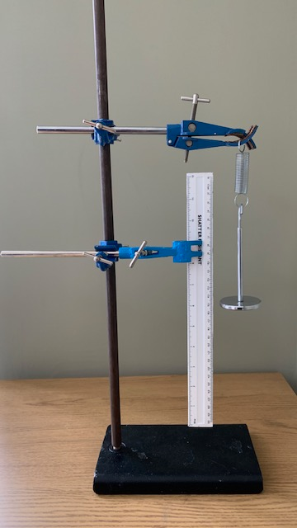
Independent Practice
What is the independent variable? (The variable you change) ​
​
What is the dependent variable?​ (The variable you measure)
​
What would you need to control? (The variables you keep the same)

Slide 3
Independent Practice - Method
Method step | Explanation
1. Hang a spring off a clamp and stand and clamp a ruler so the zero line is lined up with the bottom of the spring​
2. Add 100 g mass on the bottom of the spring and read the measurement from the base of the spring​ | ​​
3.Repeat, adding 100 g masses each time until a mass of 500 g has been reached​
4. Remove the masses and take repeated readings by doing all the masses again​ | ​ ​​

Slide 4
Mr Saville carried out a practical to investigate the extension of a spring. Write him a valid method that he could have used. (6)

Slide 5
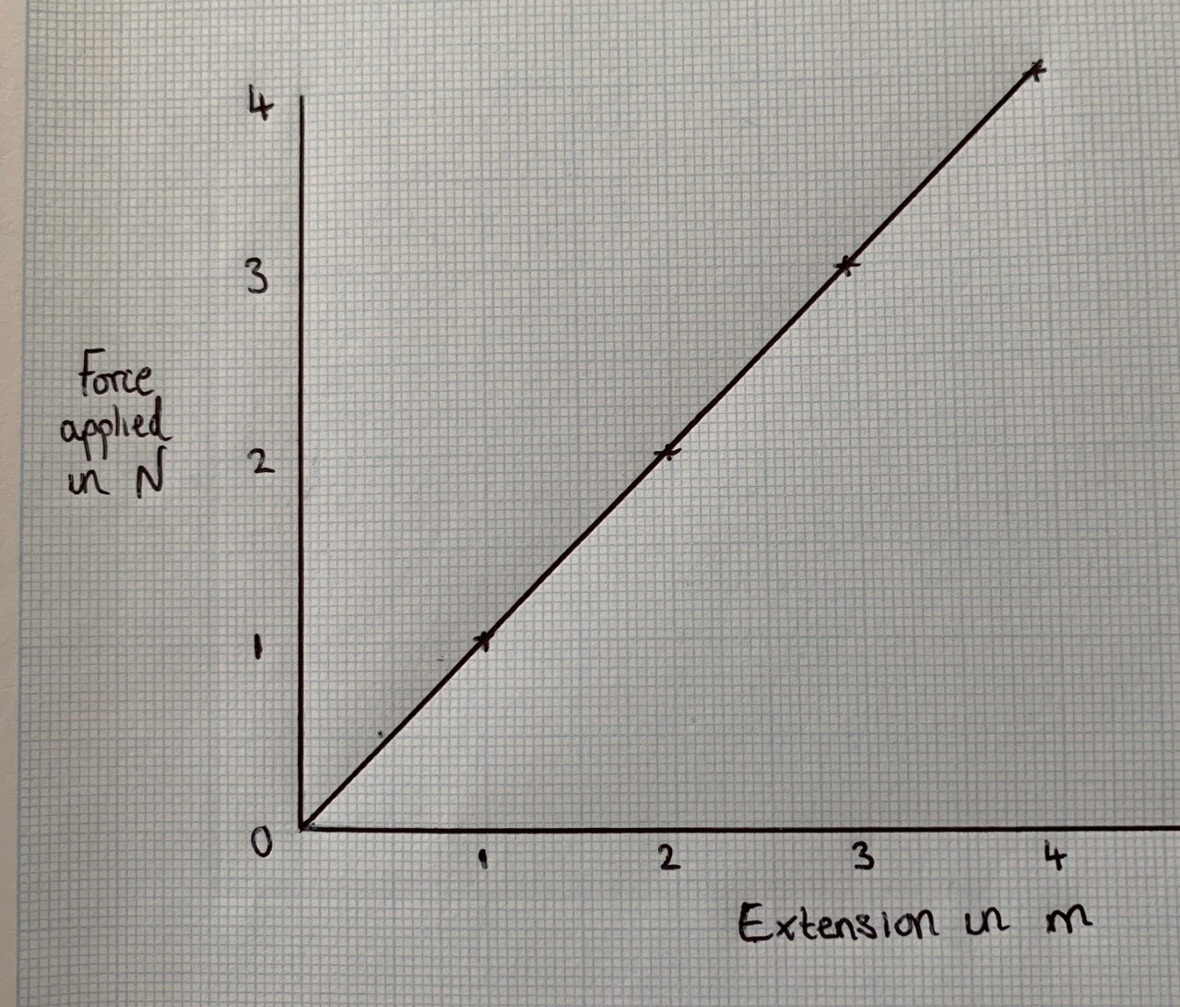
Use diagram 1 to determine the additional force needed to increase the extension in the spring from 1.5 m to 2.5 cm. Force needed = __________________ N
(1)

