Slide 1
Numbers within 10:
Exploring one less within 10
Mathematics
Lesson 7 of 10
Miss. Molnar

Slide 2
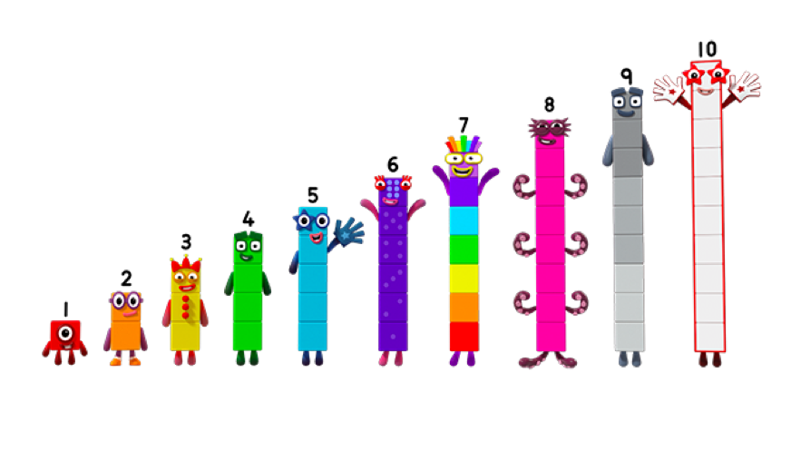
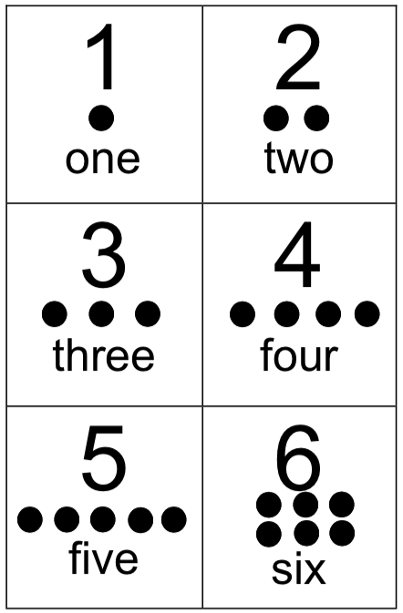
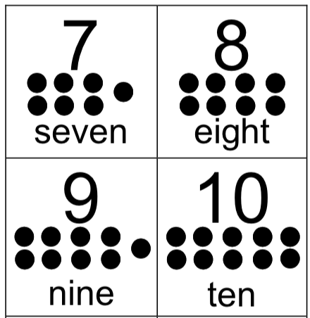
Can you choose a number up to 10 and represent one less using counting objects?
One less
than ___ is ___.
Source: Numberblocks, Images © 2017 Alphablocks Ltd. All Rights Reserved.

Slide 3
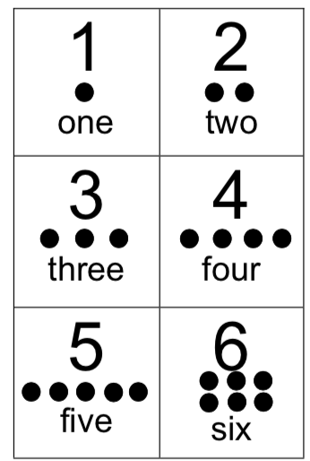
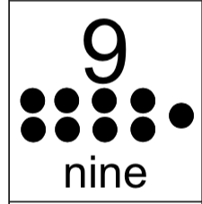
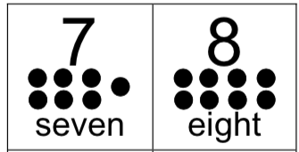

Slide 4
