Slide 1
Mathematics
Prime Deductions
Downloadable Resource
Mr Langton

Slide 2
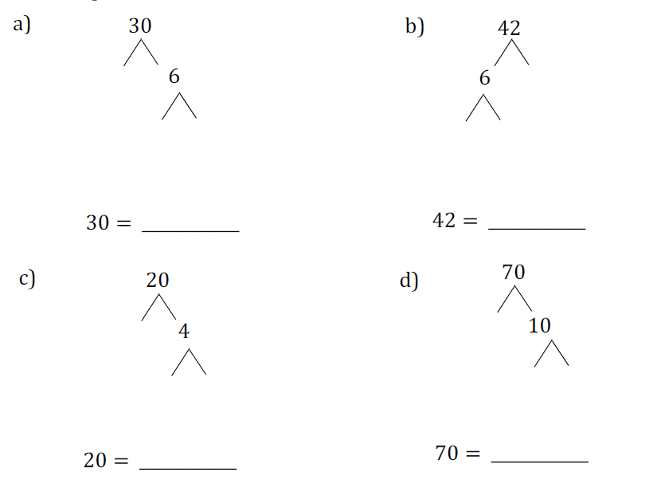
Prime Deductions
1. Complete the prime factorisation trees and write each number as a product of its prime factors.
2. Use your answers to part 1 to help work out how many factors each of the numbers 30, 42, 20, and 70 has.
3. What’s the same and what’s different about the number of factors each number has? Can you explain why this is the case?

