Slide 1
Composition Designing a poster
Communication and Language: Clothes and fashion – Applying Learning
Leanne

Slide 2
For this lesson, you will need:
Magazines
Paper
Pencil or pen
Glue
Scissors (adult supervision required)
Ruler

Slide 3
Lesson introduction
In this lesson, we will be working through the steps to create a fashion show poster.

Slide 4
Making a fashion poster
What is the show called?
Posters can be used to advertise events.
We are going to make a poster for a fashion show.
First copy the poster writing frame onto the paper using your pencil and ruler.
Where?
When?
How much are tickets?
Images from Pixabay.com

Slide 5
Making a fashion poster
Hats Hats Everywhere!
What do you want to call the fashion show? What is the focus? Hats, scarves, shoes?
Think of a fun name including your favourite item of clothing.
E.g. ‘Hats Hats Everywhere!’
Write the name in the correct box on the writing frame.
Where?
When?
How much are tickets?
Images from Pixabay.com

Slide 6
Making a fashion poster
Hats Hats Everywhere!
Where will the fashion show take place?
The garden? The living room?
When will it take place? Can you write a day of the week?
How much are the tickets?
When you have made your choices, fill in the correct boxes on the writing frame.
The garden
Sunday
£10 per ticket
Images from Pixabay.com

Slide 7
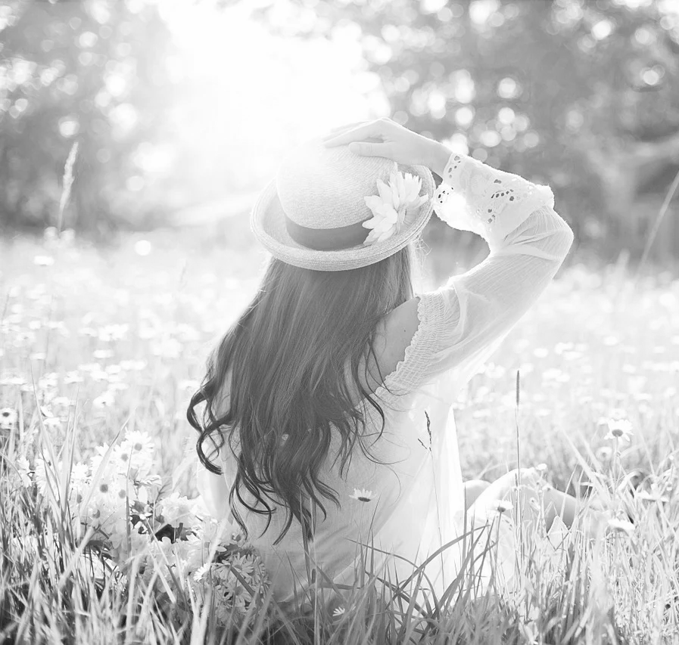
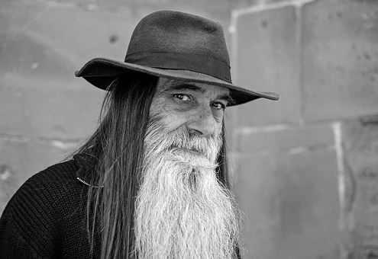
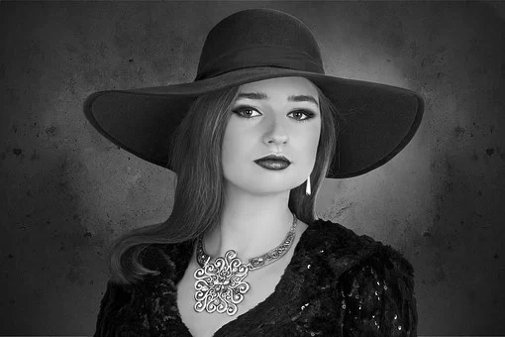
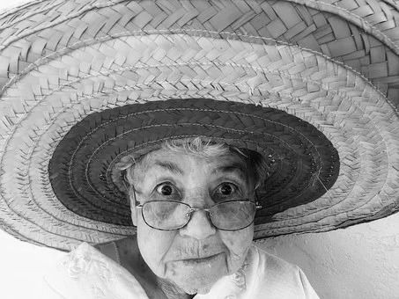
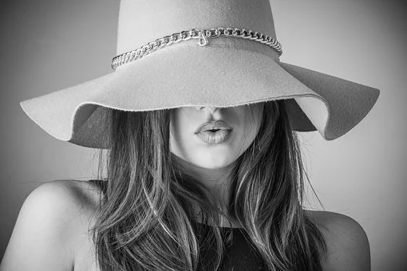
Making a fashion poster
Hats Hats Everywhere!
Now you have added the information to your poster, it is time to decorate it.
Use the magazines to find images of clothes or accessories you like.
Cut them out and glue them onto the poster.
Remember the name of your fashion show!
The garden
Sunday
£10 per ticket
Images from Pixabay.com

Slide 8
Make it easier
Make it harder
More ideas
Use symbols to support the learner.
Adult makes a poster alongside the learner.
Give the learner more choices.
Ask the learner what about different fashion items. When will you wear this? Winter? Summer?
Make a fashion magazine by taking photos or using magazines. Choose images and then comment on them. What colour is the coat?

