Slide 1
Comparing and ordering millilitres and litres
Lesson 6 of 10
Mathematics
Miss Jones

Slide 2
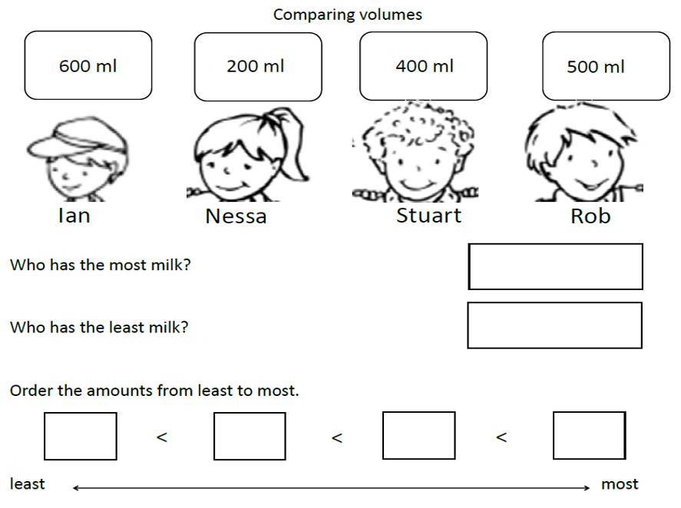

Slide 3
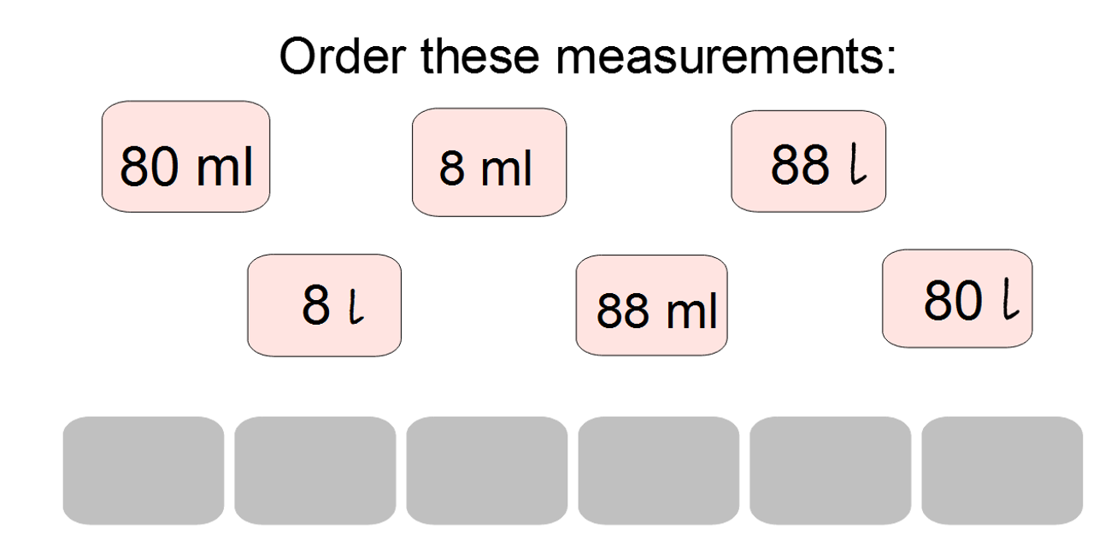
Don’t forget the unit of measure!

