Slide 1
Mathematics
Understanding percentage
Mr Kelsall

Slide 2
New learning: percent
What percentage of the whole string is 60 beads?
What percentage of the whole string is 43 beads?
Notes:
READ SLIDES

Slide 3
New learning: percent
What percentages of the whole string can you represent?
30% means 30 out of 100; 30 beads is 30% of the whole string.
30% 21% 35% 45% 3% 100% 17% 90% 50% 101%
Notes:
READ SLIDES

Slide 4
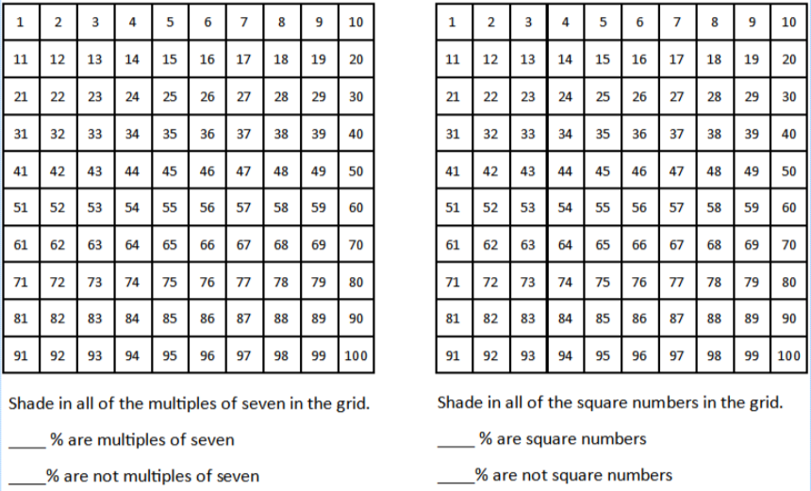
Develop learning: percent
Notes:
READ SLIDES

Slide 5
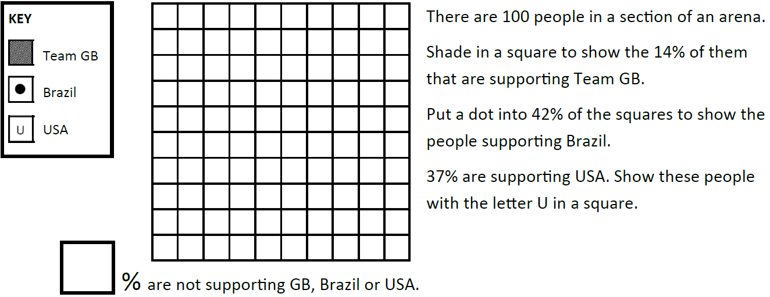
Independent learning
Notes:
READ SLIDES

Slide 6
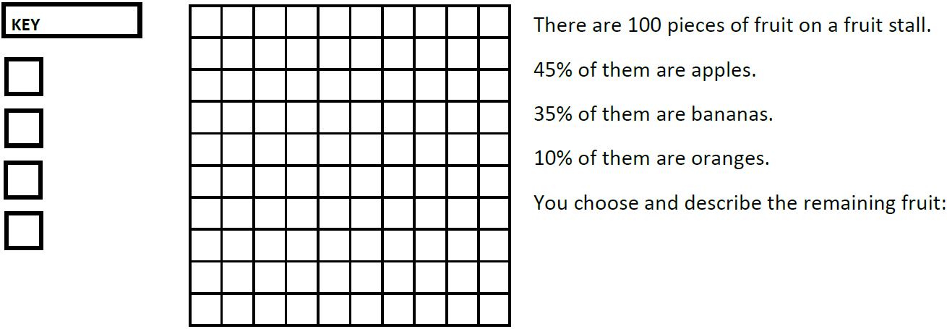
Independent learning
Notes:
READ SLIDES

Slide 7
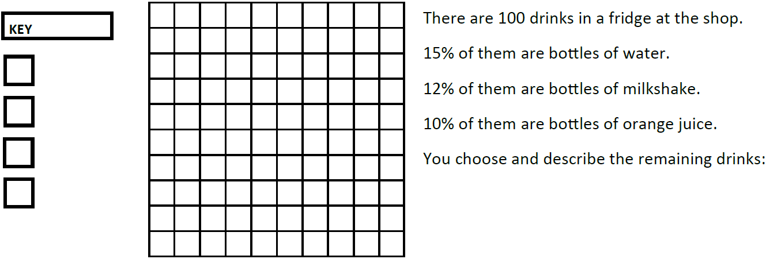
Independent learning
Notes:
READ SLIDES

