Slide 1
Surface area and volume of a hemisphere
Mr Chan
Maths

Slide 2
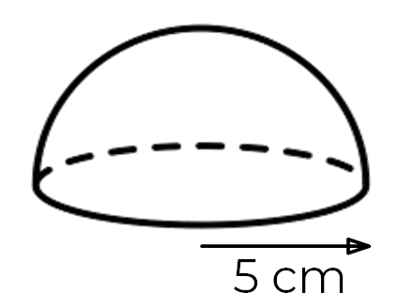
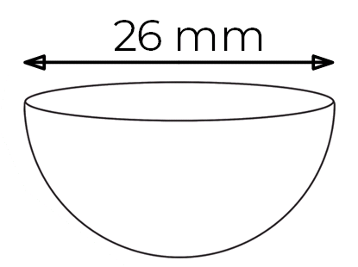
Surface area and volume of a hemisphere

Slide 3
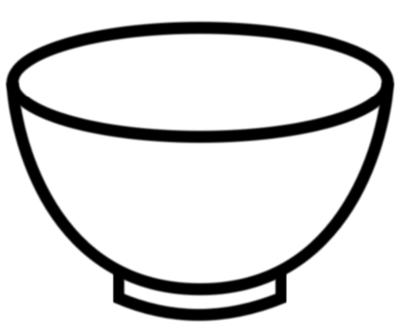
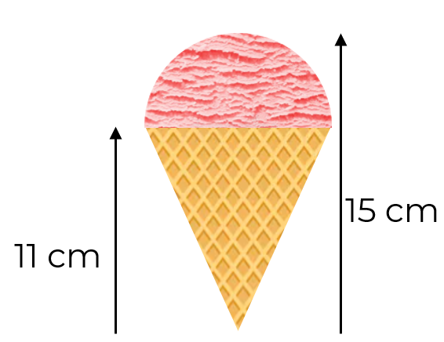
Surface area and volume of a hemisphere
3. Jamie has a bowl in the shape of a hemisphere with
a diameter of 12 cm.
a) Work out the surface area of the outside of the bowl.
b) Jamie is going to pour 480 cm³ of soup into the bowl.
Work out if the bowl is large enough to pour all of the soup.
4. The ice cream on top of a cone is in the shape of a hemisphere.
The cone has a height of 11 cm and the total height is 15 cm.
Work out the volume of ice cream rounded to 1 decimal place.
FreeSVG

Slide 4
Answers

Slide 5
Surface area and volume of a hemisphere
1592.8 mm²

Slide 6
Surface area and volume of a hemisphere
3. Jamie has a bowl in the shape of a hemisphere with
a diameter of 12 cm.
a) Work out the surface area of the outside of the bowl.
b) Jamie is going to pour 480 cm³ of soup into the bowl.
Work out if the bowl is large enough to pour all of the soup.
4. The ice cream on top of a cone is in the shape of a hemisphere.
The cone has a height of 11 cm and the total height is 15 cm.
Work out the volume of ice cream rounded to 1 decimal place.
FreeSVG
No, the bowl is too small. (452 cm³)
134.0 cm³

