Slide 1
What can I do as a citizen to protect the rights of others?
Worksheet
Citizenship
Mr Miskell

Slide 2
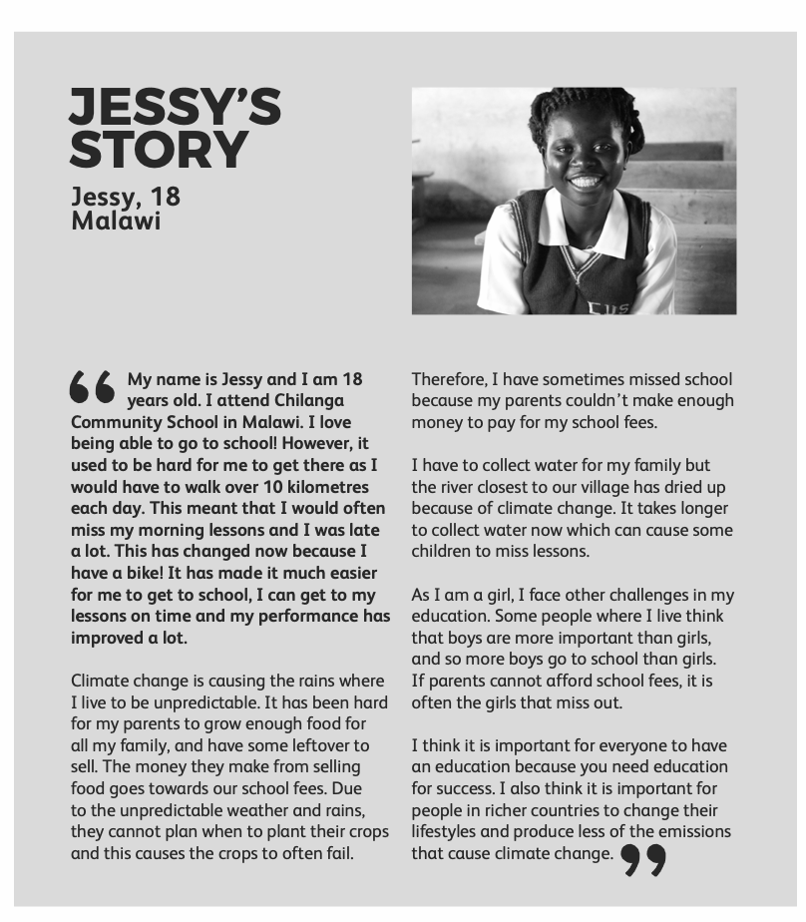
Source: Send My Friend To School
Step 1

Slide 3
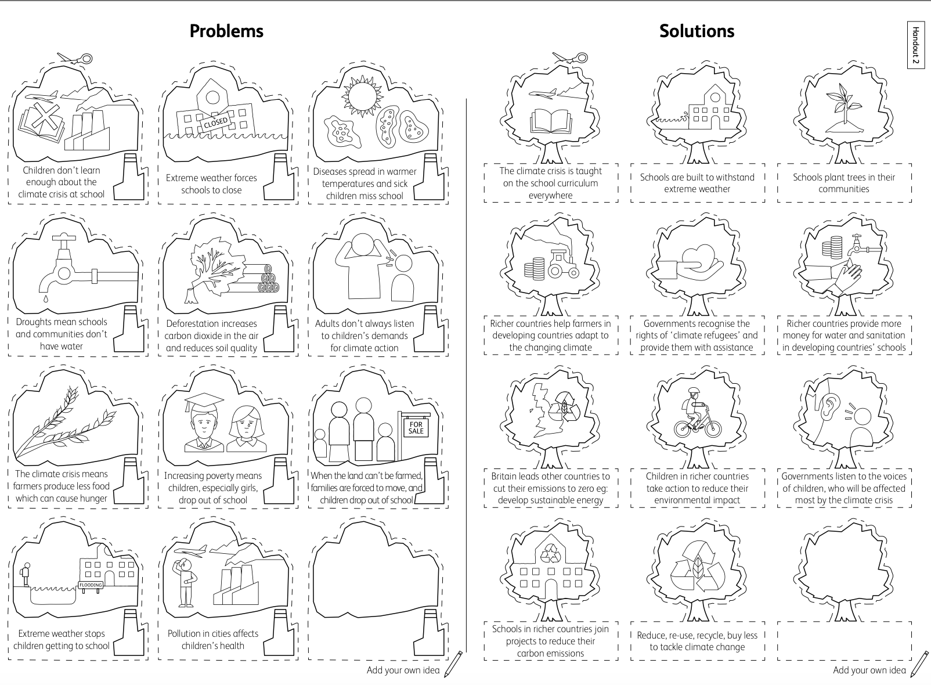
Step 2 & 3
Source: Send My Friend To School

Slide 4
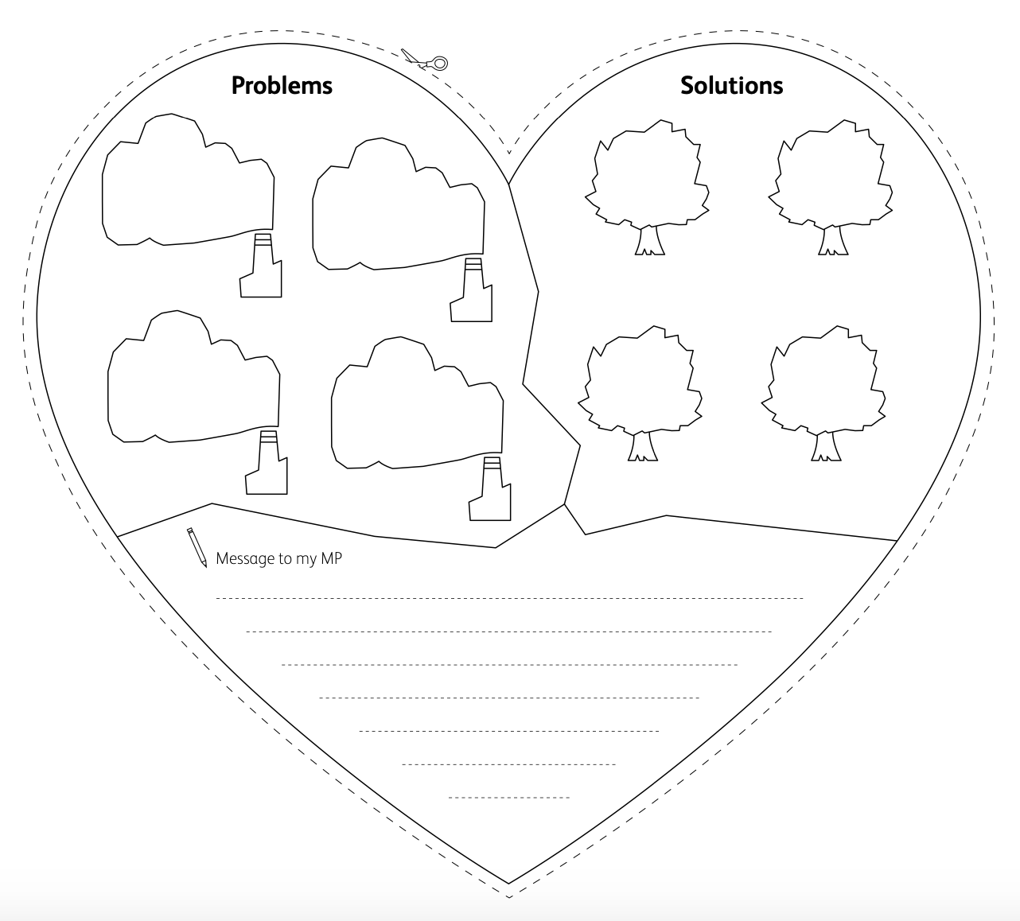
Step 3
Source: Send My Friend To School

