Slide 1
Further constructions
Independent Task
Mathematics
Miss Oreyomi
Miss Oreyomi

Slide 2
Questions

Slide 3
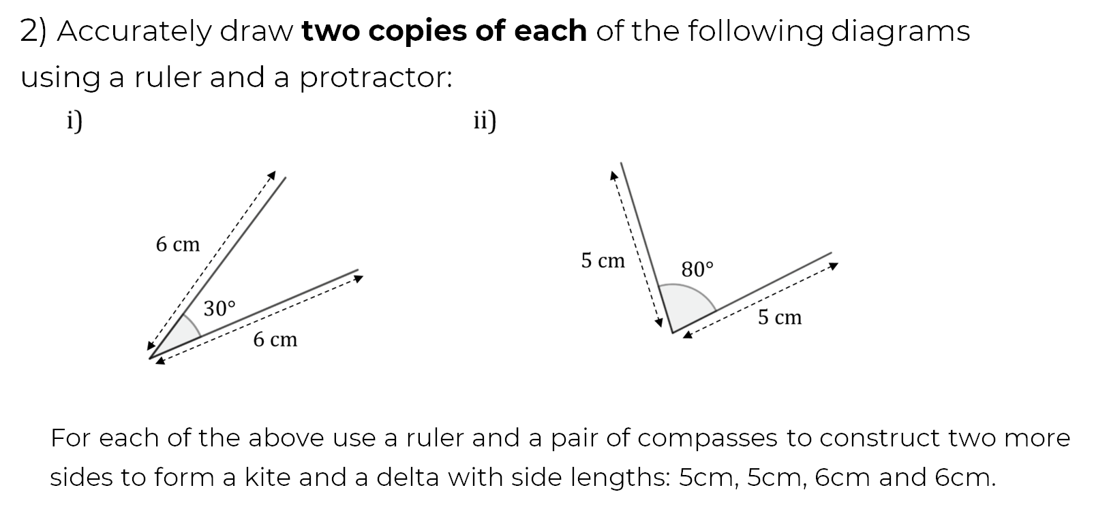
Questions

Slide 4
Questions

