Slide 1
Convert small numbers to standard form
Maths
Mr Chan

Slide 2
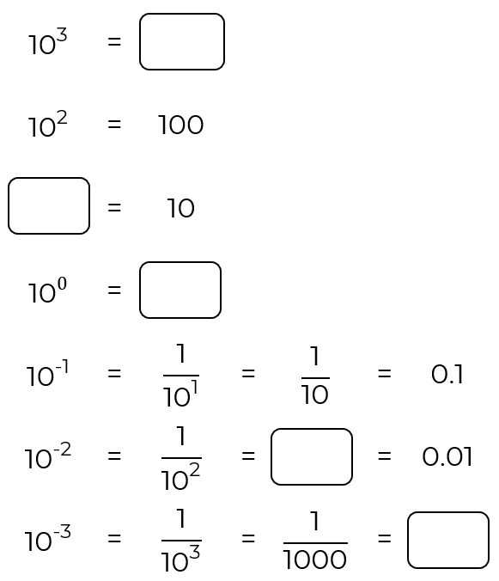
Convert small numbers to standard form
1. Fill in the blanks.

Slide 3
Convert small numbers to standard form
4. Write these numbers in standard form.
0.004
0.021
0.007 01
0.000 812
0.000 009
0.000 000 989
5. Violet light has a wavelength of approximately 0.000 000 4 m.
Write this number in standard form.
6. Here are some number cards.
Put them into order starting with the smallest.

Slide 4
Answers

Slide 5
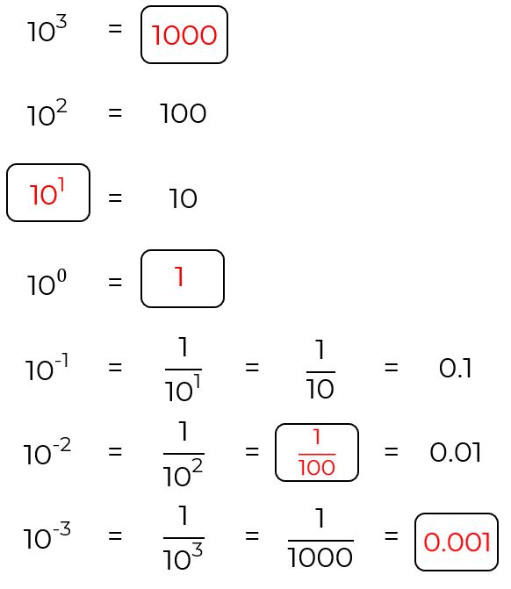
Convert small numbers to standard form
1. Fill in the blanks

Slide 6
Convert small numbers to standard form

