Slide 1
Addition and Subtraction Problems
Downloadable Resource
Mathematics
Mrs Harris

Slide 2
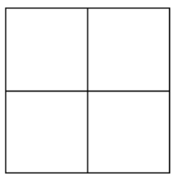
Choose 4 different digits.
This gives 4 two-digit numbers.
Find the sum of all the numbers.
Try other examples. What do you notice?
Notes:
Introduce self and brief overview of the lesson

Slide 3
Which weighs more, and by how much:
A rhino and zebra weighed together on Jupiter, or an elephant and rhino weighed together on Venus?
Object | Weight on Earth (N) | Weight on Jupiter (N) | Weight on Venus (N)
Human | 72 | 187 | 65
Elephant | 7200 | 18720 | 6480
Rhino | 3000 | 7800 | 2700
Dog | 30 | 78 | 27
Zebra | 360 | 936 | 324
Cat | 2 | 5 | 2
Notes:
Introduce self and brief overview of the lesson

Slide 4
Independent learning - Questions
Menu | Price
Burger | £4.95
Cheeseburger | £5.55
Chips | £1.99
Salad | £2.50
Fruit bag | £0.70
Banana | £0.45
Milkshake | £2.09
Bottle of water | £0.69
Anne buys a cheeseburger, salad, a banana and a bottle of water. How much does she pay?
Sally buys a burger, chips and a bottle of water. She pays with a £20 note. How much change does she get?
Fin buys three items. He pays with a £10 note and gets less than £2 change. What could he have bought?

