Slide 1
Lesson 4: Exploring position and direction of different objects
Lesson 4 of 4
Numeracy: Position and Direction - Building Understanding
Simon

Slide 2
What are we going to learn today?
To explore the relative position and direction of objects.
To respond to key vocabulary associated with position and direction.
To experience the application of key vocabulary within an exploratory activity.
Key Vocabulary
sculpture on top middle bottom size

Slide 3
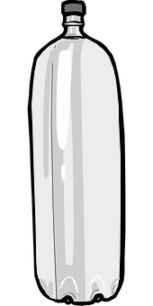
Let’s look at some of the key words and what they mean
I want to put the bottle on the box. The bottle is on the box.
Put one of your items on another one.
Images from Pixabay

Slide 4
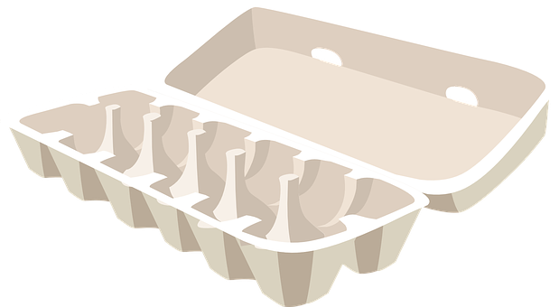
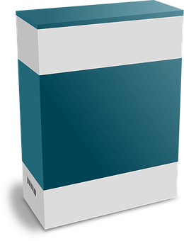
Let’s look at some of the key words and what they mean
I want to put the egg box on top of the box. The egg box is on top.
Put one of your items on top of another one.
Images from Pixabay

Slide 5
Let’s look at some of the key words and what they mean
I want to put the cup on the side of the bottle. The cup is on the side.
Put one of your items on the side of another one.
Images from Pixabay

Slide 6
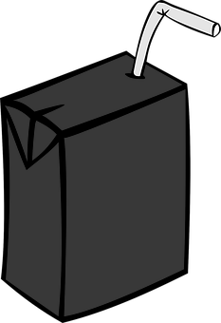
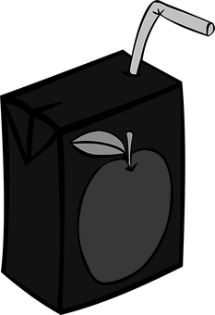
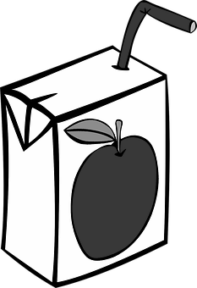
Let’s look at some of the key words and what they mean
This juice box is at the top of the bottle.
This juice box is in the middle.
This juice box is at the bottom.
Images from Pixabay

Slide 7
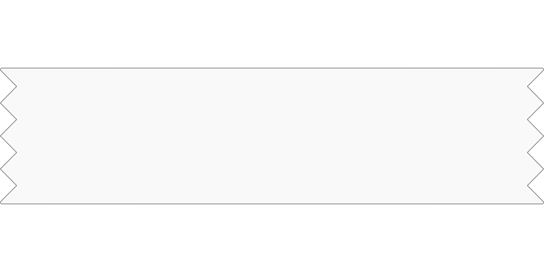
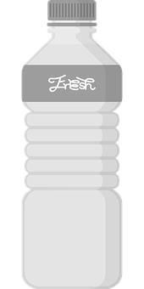
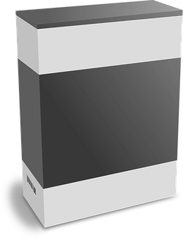
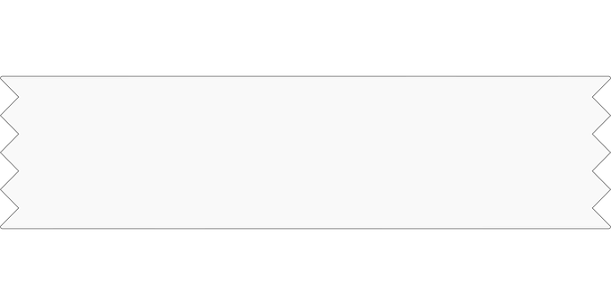
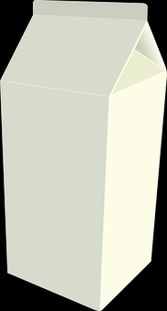
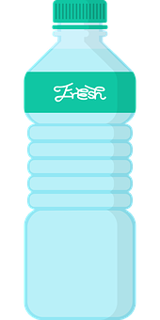
It is your turn. Take the items you have and construct some sculptures.
Images from Pixabay

Slide 8
Task - Experiment with position and direction by making some sculptures
Instruction
Use your own objects as well as glue or tape to construct some sculptures. It could look like something or be abstract.
Suggestions
A parent or carer may model the language associated with position. For example, ‘you have put the cup on top of the box.’
A parent or carer may ask you questions about where things are.

Slide 9
I have followed these instructions
Put the bottle on the box.
Put the carton on top of the bottle.
Put the cups on the side of the carton.
Images from Pixabay

Slide 10
Task - Following instructions about position and direction
Instruction
Your parent or carer will choose an item and tell you where to put it. You need to listen carefully to the instruction and try to follow it.
Suggestions
You could watch an adult do it first as they say the instruction ‘on top’ or ‘side’, for example. Then you could copy.
You could then try to follow the instruction more independently.

Slide 11
Unit 5 Lesson 2: Exploring position and direction of different objects
Make it easier
Make it harder
Other ideas
Focus on stacking and the key vocabulary of ‘on top’, repeating as each item is stacked on top of the next.
Use familiar stacking toys such as lego or duplo.
Describe a sculpture that a parent or carer should make. Be clear as you give them instructions so that the sculpture looks just as you imagined.
While you are on a walk, you could use natural materials and experiment with position and direction as you arrange them in a pattern or sculpture.

