Slide 1
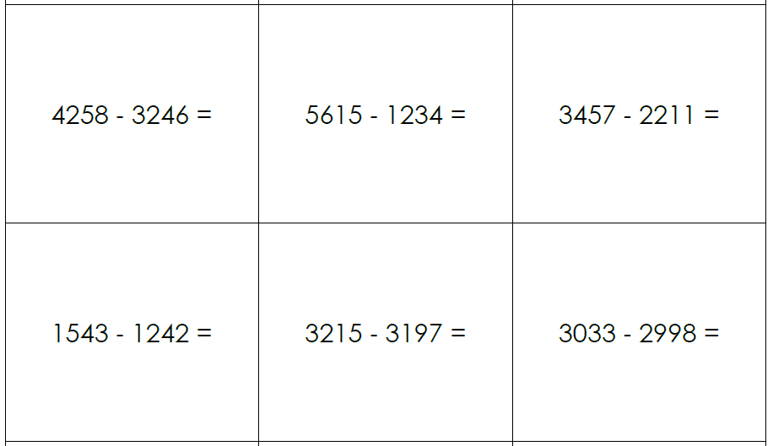
Independent Task
Questions
2009 - 1858 =
3457 - 1998 =
Solve the following equations using the most efficient method.
Challenge: Can you explain why you chose your method?

