Slide 1
The Painted Cube problem.
Downloadable resource.
Mathematics
Mr Millar

Slide 2
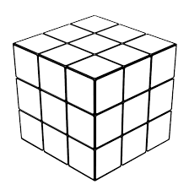
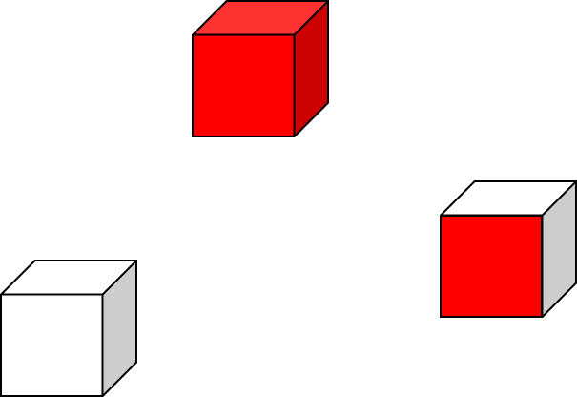
A 3x3x3 cube is put together using smaller white pieces.
The outside is painted red and left to dry.
The large cube is then taken apart piece by piece.
What do the smaller pieces look like?
I know that the cubes in the corner have _____ faces painted.
I know how many cubes have 0 faces painted!

Slide 3
Let’s think about the number of cubes with 1 or 2 faces painted.
# Faces painted | Where? | # Cubes
3 | Corners | 8
2
1
0 | “Inside” | 1

Slide 4
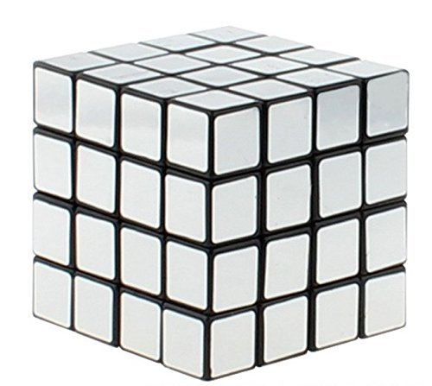
Now let’s think about a 4 x 4 x 4 cube.
# Faces painted | Where? | # Cubes
3 | Corners
2
1
0 | “Inside”

Slide 5
Now let’s think about an n x n x n cube.
# Faces painted | Where? | # Cubes
3 | Corners
2
1
0 | “Inside”

Slide 6
Answers

Slide 7
A 3x3x3 cube is put together using smaller white pieces.
The outside is painted red and left to dry.
The large cube is then taken apart piece by piece.
What do the smaller pieces look like?
I know that the cubes in the corner have 3 faces painted.
I know how many cubes have 0 faces painted!
1

Slide 8
Let’s think about the number of cubes with 1 or 2 faces painted.
# Faces painted | Where? | # Cubes
3 | Corners | 8
2 | Along the edges (not the corners) | 12
1 | In the middle of the faces | 6
0 | “Inside” | 1

Slide 9
Now let’s think about a 4 x 4 x 4 cube.
# Faces painted | Where? | # Cubes
3 | Corners | 8
2 | Along the edges (not the corners) | 24
1 | In the middle of the faces | 24
0 | “Inside” | 8

Slide 10
Now let’s think about an n x n x n cube.
# Faces painted | Where? | # Cubes
3 | Corners | 8
2 | Along the edges (not the corners) | 12n - 24
1 | In the middle of the faces
0 | “Inside”
On each of the 2 “end” rows, 4n-8 faces
On the (n-2) “middle” rows, 4.
2(4n -8) + 4(n-2) = 12n - 24
6 faces, (n-2)² in the middle of each face
Note that these sum to n³ cubes!

