Slide 1
Lesson 2: Lights and Drums
Representations - from Clay to Silicon
Computing
Sara Alade
Materials from the Teach Computing Curriculum created by the National Centre for Computing Education

Slide 2
Task 1 - Communication at a distance
Two friends live in huts on opposite sides of a great lake.
They would like to exchange messages from a distance?
Answer:-
Notes:
As learners enter the classroom, there is a scenario displayed on a slide: “Two friends live in huts on opposite sides of a great lake. How can they exchange messages?”. Ask them to consider this scenario.
Leave this slide on, until the allocated time is over.
Image source:
https://en.wikipedia.org/wiki/Lake#/media/File:Lake_mapourika_NZ.jpeg

Slide 3
Task 2 - Encoding in Morse code
Can you work out the following Morse code?
-- | -- | .-. | ... | . |  | -.-. | --- | -.. | .
.. | ... |  | ..-. | ..- | -.
Credit: Morse Code Alphabet: Wikipedia
Notes:
Describe the activity to the learners. Tell them that they will be working in groups.
They will be given a worksheet that contains a short message, a scheme that describes how they are supposed to encode that message, and communication equipment that will allow them to transmit that message to other groups.
They will need to find a way to transmit their message to the other groups, using the equipment. They will also receive messages from other groups and decode them.
Image sources:
https://commons.wikimedia.org/wiki/Category:Signalling_lamps#/media/File:The_Royal_Navy_during_the_Second_World_War_A8066.jpg
https://en.wikipedia.org/wiki/Slit_drum#/media/File:TamTam.jpg

Slide 4
Task 3 - Encode
Using the Morse coding scheme, encode the message “Kitty” below.
Hint: use a sequence of “dot” and “dash” (Morse code table to the right).
K | i | t | t | y
Credit: Morse Code Alphabet: Wikipedia
Notes:
Describe the activity to the learners. Tell them that they will be working in groups.
They will be given a worksheet that contains a short message, a scheme that describes how they are supposed to encode that message, and communication equipment that will allow them to transmit that message to other groups.
They will need to find a way to transmit their message to the other groups, using the equipment. They will also receive messages from other groups and decode them.
Image sources:
https://commons.wikimedia.org/wiki/Category:Signalling_lamps#/media/File:The_Royal_Navy_during_the_Second_World_War_A8066.jpg
https://en.wikipedia.org/wiki/Slit_drum#/media/File:TamTam.jpg

Slide 5
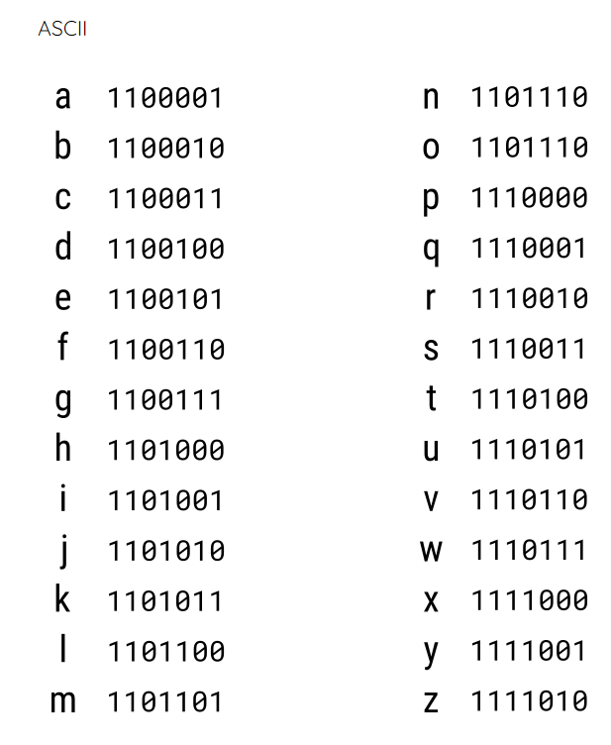
Task 4 - Receive
Your decoded message should look like this:-
1101011 | 1101001 | 1110100 | 1110100 | 1111001
Notes:
Describe the activity to the learners. Tell them that they will be working in groups.
They will be given a worksheet that contains a short message, a scheme that describes how they are supposed to encode that message, and communication equipment that will allow them to transmit that message to other groups.
They will need to find a way to transmit their message to the other groups, using the equipment. They will also receive messages from other groups and decode them.
Image sources:
https://commons.wikimedia.org/wiki/Category:Signalling_lamps#/media/File:The_Royal_Navy_during_the_Second_World_War_A8066.jpg
https://en.wikipedia.org/wiki/Slit_drum#/media/File:TamTam.jpg

