Slide 1
Circuits - Download
Physics - Key Stage 3
Lesson 1 - Electricity and Magnetism
Miss White

Slide 2
Questions from video

Slide 3
Quick Check 1
What is the role of the wires?
What is the role of a cell?
What is a battery?
What happens in a filament lamp when current flows through it?

Slide 4
Quick Check 1 - Hints
What is the role of the wires?
The wires ______________ the components.
What is the role of a cell?
The cell has a store of __________ energy so the components can do work.
What is a battery?
A battery is made up of two or more ___________.
What happens in a filament lamp when current flows through it?
Energy is ___________ into the filament lamp so there will be an increase in the ___________ store when current flows through it.

Slide 5
Quick Check 2
What is the role of the ammeter?
What is the role of a voltmeter?
What is a switch?
A circuit contains 1 cell and 1 filament lamp. What would be the effect on the lamp of adding more cells?

Slide 6
Quick Check 2 - Hints
What is the role of the ammeter?
The ammeter measures _____________.
What is the role of a voltmeter?
The voltmeter measures _____________ _______________.
What is a switch?
A switch __________ or reconnects a circuit.
A circuit contains 1 cell and 1 filament lamp. What would be the effect on the lamp of adding more cells?
If more cells are added the filament lamp will become __________.

Slide 7
Match the symbol to the component
Battery
Open Switch
Wire
Resistor
Cell
Voltmeter
Lamp
Ammeter
Notes:
Draw each symbol and write the correct name next to each one.

Slide 8
Draw series circuits with...
Two lamps
One battery
One lamp
One cell
One lamp
One cell
An open switch
One cell
One lamp
One ammeter
Notes:
•Draw the circuit symbols first, then
•Draw all the wires
use a ruler and do not let the wires cross each other.
If the circuit is a SERIES circuit, the order of components doesn’t matter for those we are dealing with here.

Slide 9
Copy and complete...
Electrical current is the movement of __________. These are simply ___________. The charges transfer ___________ from the __________ to the components (eg filament lamp).

Slide 10
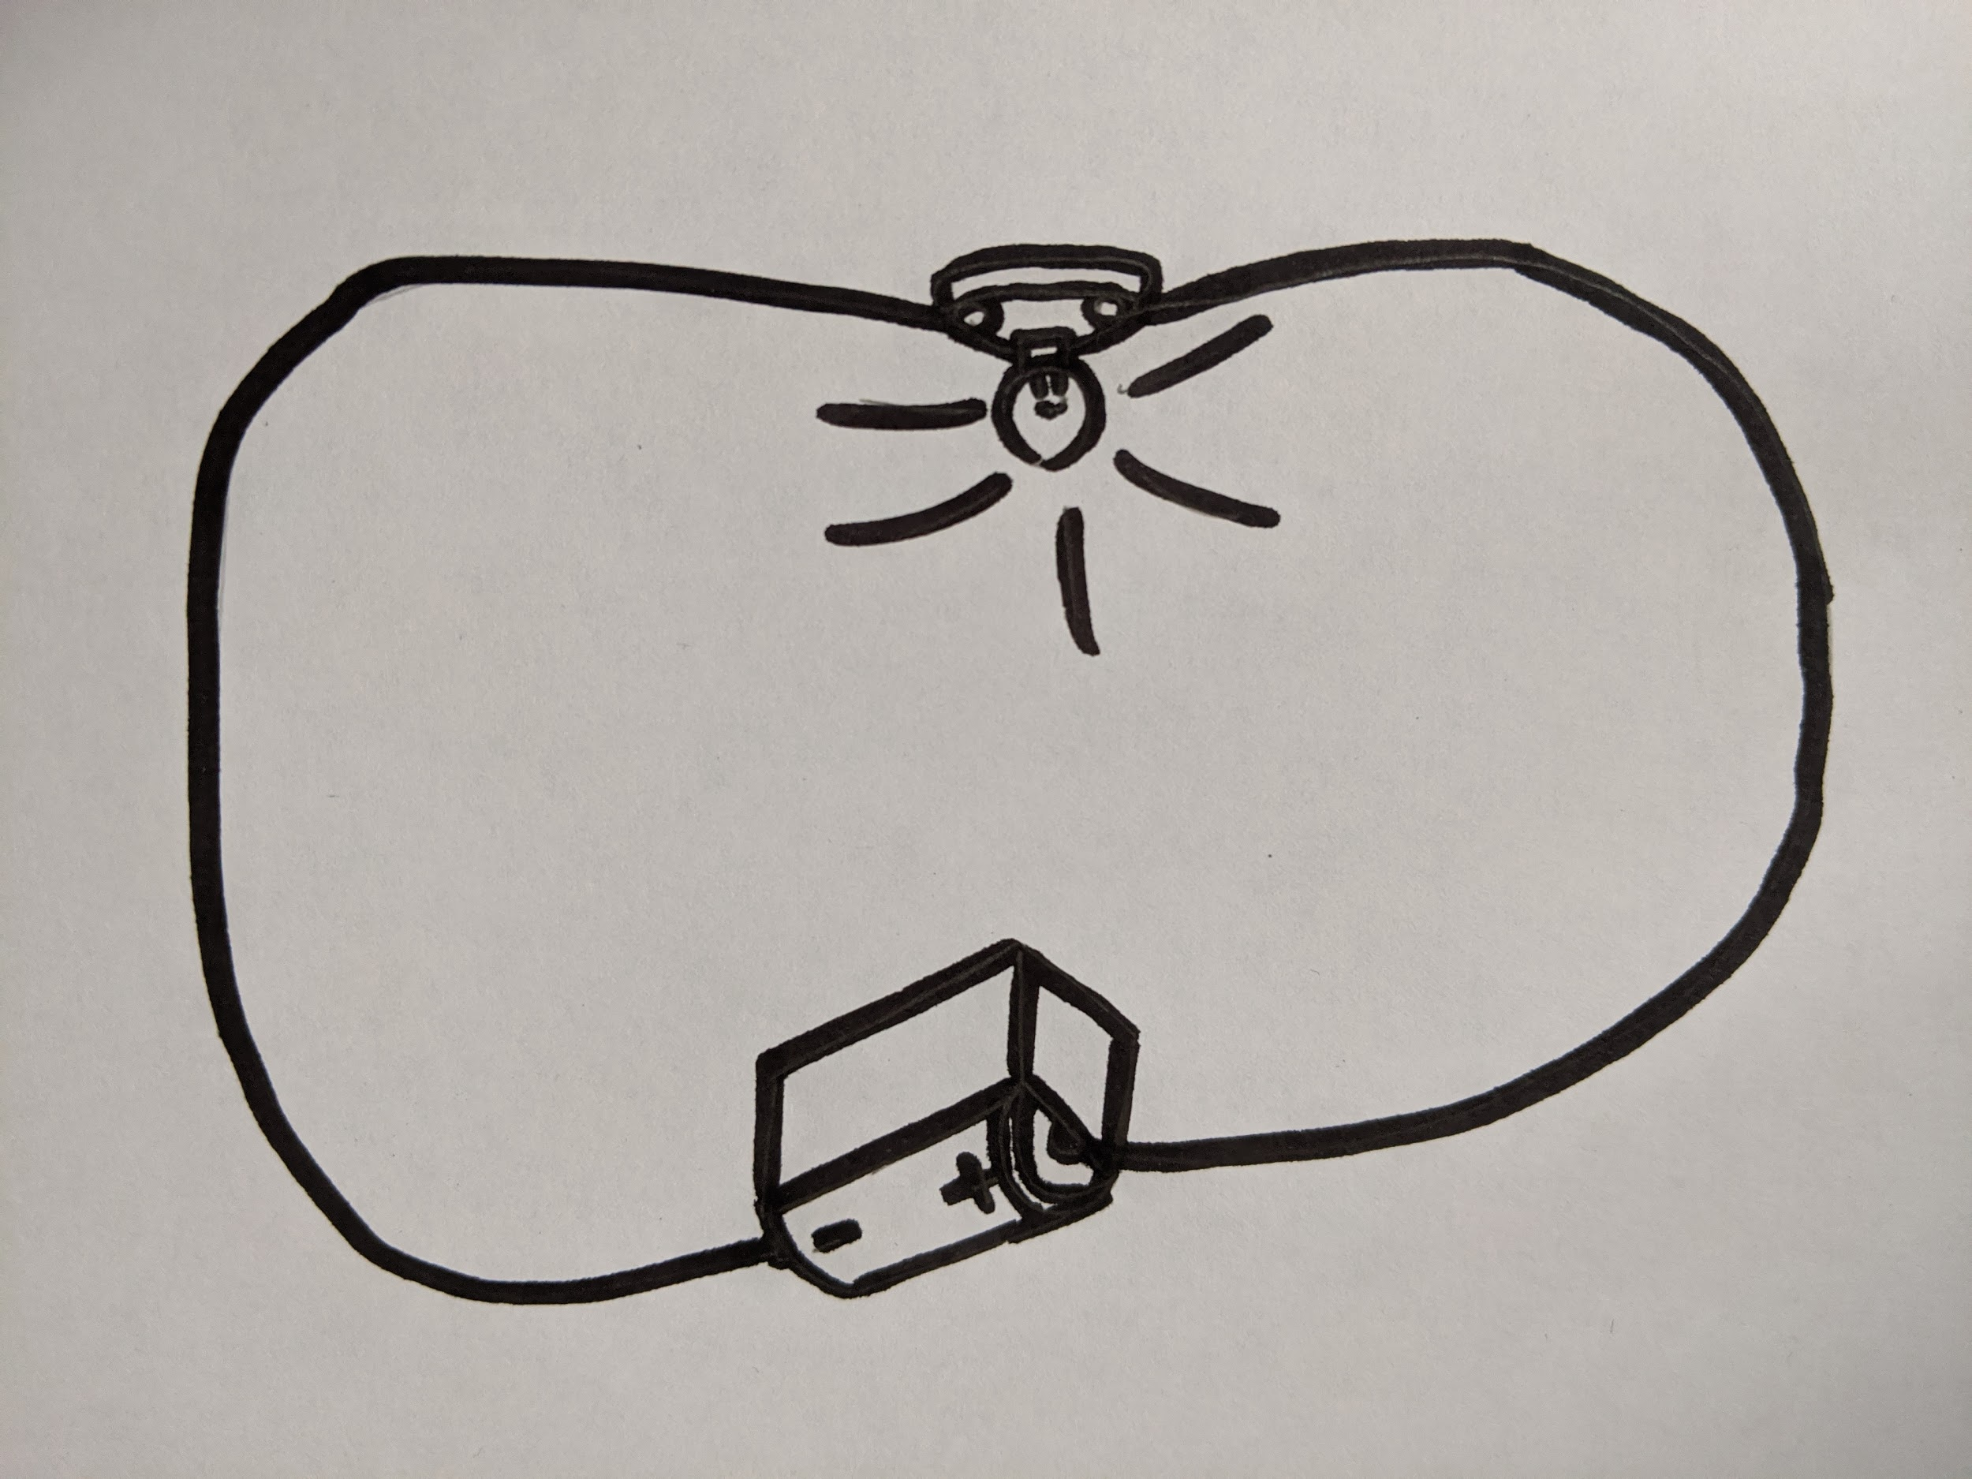
Independent Task
Use the model to help you explain why the filament lamp lights
Scaffold:
Describe the role of the cell
State what the charges carry
Say where the charges come from
Describe what is transferred to the lamp (use the idea of energy stores in your answer)
Source: Miss White

Slide 11
Independent Task pt2
How could we change the circuit to make the filament lamp brighter?
If the circuit is left on, why will the battery ‘go flat’ eventually?
Source: Miss White

Slide 12
Answers

Slide 13
Quick Check 1 - Answers
What is the role of the wires?
The wires connect the components.
What is the role of a cell?
The cell has a store of chemical energy to transfer to the components.
What is a battery?
A battery is made up of two or more cells.
What happens in a filament lamp when current flows through it?
Energy is transferred into the filament lamp so there will be an increase in the thermal store when current flows through it.

Slide 14
Quick Check 2 - Answers
What is the role of the ammeter?
The ammeter measures current.
What is the role of a voltmeter?
The voltmeter measures potential difference.
What is a switch?
A switch breaks or reconnects a circuit.
A circuit contains 1 cell and 1 filament lamp. What would be the effect on the lamp of adding more cells?
If more cells are added the filament lamp will become brighter

Slide 15
Match the symbol to the component - Answers
Wire
Open Switch
Lamp
Resistor
Battery
Ammeter
Cell
Voltmeter
Notes:
What is the unlabelled component?

Slide 16
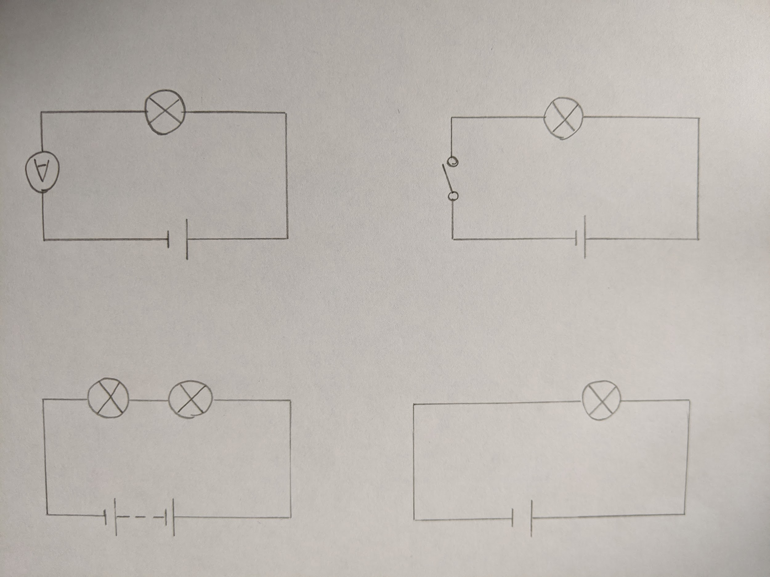
Circuit drawing - Answers
Two lamps
One battery
One lamp
One cell
One cell
One lamp
One ammeter
One lamp
One cell
An open switch
Source: Miss White

Slide 17
Copy and complete - Answers
Electrical current is the movement of charges. These are simply electrons. The charges transfer energy from the cell to the components (eg filament lamp).

Slide 18
Independent task - Answers
•The cell transfers energy to the charges and they move around the circuit. The charges are already in the wires so the filament lamp lights instantly.
As the charges pass through the filament lamp, energy is transferred to the thermal store of the filament in the filament lamp.
To make the same filament lamp brighter, another cell could be added. This works because more energy is transferred to the charges so they possess more energy for every charge
The cell would eventually go flat because the chemical store would decrease to zero

