Slide 1
Asking and answering questions about belongings [2/ 2]
-using Lieblings- to say your favourites
-forming open questions
German
Frau Johnson

Slide 2
Asking and answering questions about belongings
your understanding of the near future tense.
Phonics focus [ei] and [ie]
Introducing vocabulary
Introducing Lieblings- to say favourite
Introducing forming open questions
Deepening understanding: reading and listening
Translation
Summarising learning

Slide 3
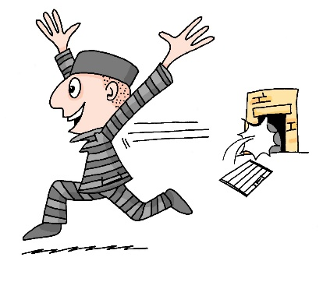
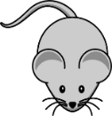
ei
sein
klein
[to be]
frei
/a
leider
ein
[unfortunately]

Slide 4
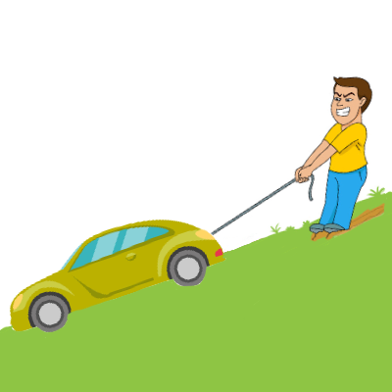
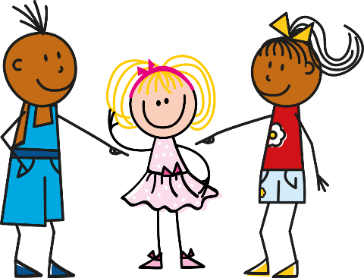
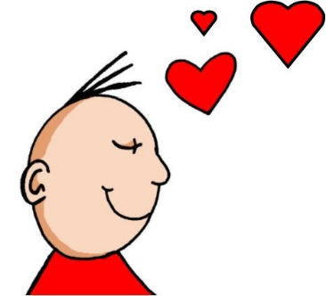
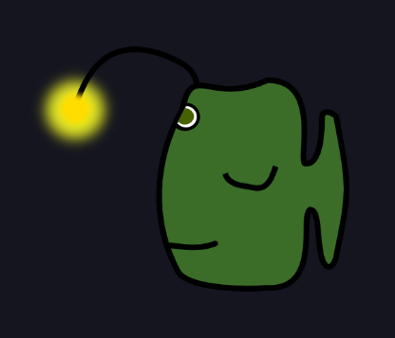
ie
ziehen
sie
Liebe
Brief
tief
2000 Kilometer
liegen

Slide 5
der Kuli | pen
der Freund | friend
der Film | film
die Uhr | watch/ clock
die Flasche | bottle
das Lied | song
das Haustier | pet
das Buch | book

Slide 6
Using Lieblings- to say your favourite
In German you add the prefix Lieblings- to a noun to talk about your favourite things.
You introduce them using the possessive adjective mein, meine, mein.
Mein Lieblingstier ist ein Tiger.
My favourite animal is a tiger.

Slide 7
Asking and answering questions with Lieblings-
One way of asking questions with Lieblings- is to use ‘Hast du?’ plus the indefinite article in the accusative or in a negative response keinen/ keine/ kein.
Hast du einen Lieblingsfilm?
Ja, ich habe einen Lieblingsfilm.
Nein, ich habe keinen Lieblingsfilm.

Slide 8
Asking and answering questions with Lieblings-
You can also ask questions about favourites in a different way.
Was ist dein Lieblingstier?
What is your favourite animal?

Slide 9
Asking and answering questions with Lieblings-
When you ask questions like this you need to use the possessive adjectives ‘dein’ and ‘mein’. These follow same pattern as ein.
Was ist deine Lieblingsfarbe?
Meine Lieblingsfarbe ist blau.
In both of these you use the ein, eine, ein pattern.

Slide 10
Asking yes/no questions
In English to ask a yes/no question ‘do you’ is followed by a verb.
Statement
You have a pet.
Question
Do you have a pet?

Slide 11
Asking yes/no questions
In German you just swap (invert) the subject and the verb.
There is no ‘do’.
Statement
Du hast ein Haustier.
Question
Hast du ein Haustier?
Verb
Subject

Slide 12
Asking yes/no questions
This works with most verbs.
There is no ‘do’.
Statement
Du spielst Tennis.
Question
Spielst du Tennis?
Verb
Subject

Slide 13
Forming open questions
To create an open question you place a question word in front of the verb.
Question
Remember the verb and subject still swap.
Wo
ist das Tier?
Verb
Subject

Slide 14
Forming open questions
This works with all verbs.
Remember the verb and subject still swap.
Question
Remember the verb and subject still swap.
Wo
spielst du Tennis?
Verb
Subject

Slide 15
Asking and answering questions about belongings.
In German Lieblings- means _________.
Mein/Dein follow the same pattern as ________.
You use the accusative case after most _______.
In open questions the question word comes _______.
The verb comes _________.
favourite
ein
verbs
first
second

