Slide 1
Depth of numbers within 15
Mathematics
Independent Task
Miss Robson

Slide 2
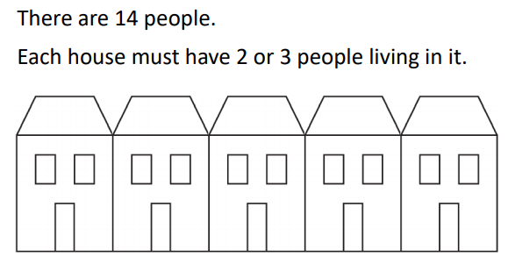
Activity

