Slide 1
Maths
Draw Quadratic Graphs (Negative 𝑥²)
Miss Davies

Slide 2
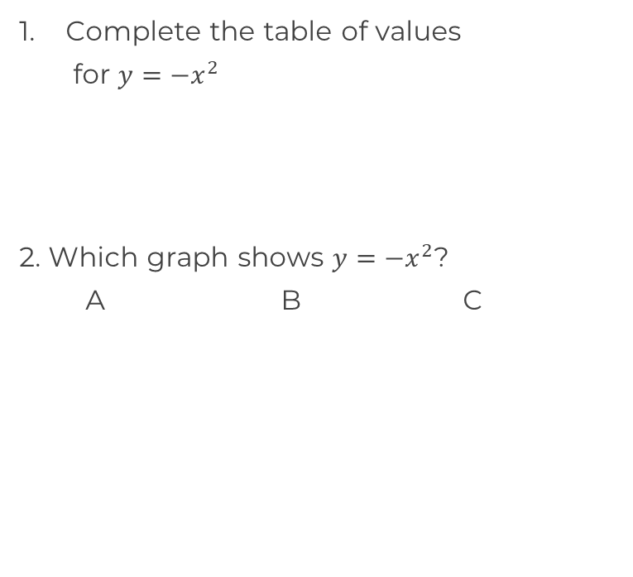
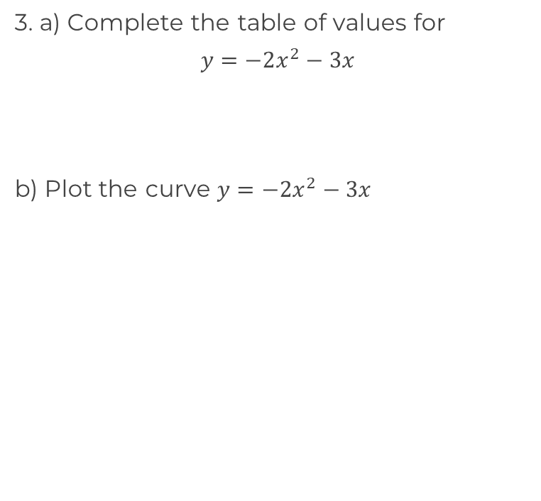
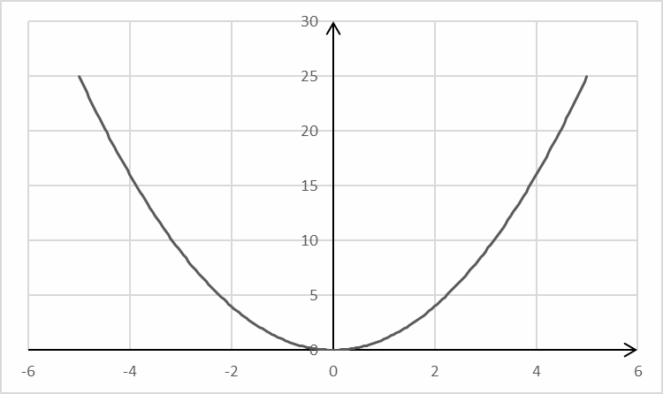
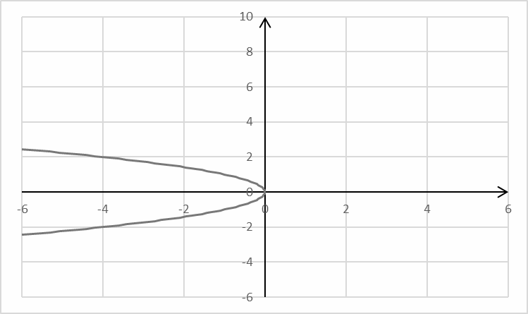
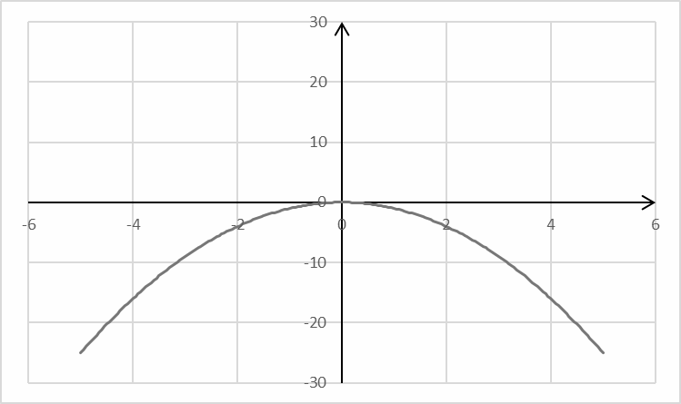
Plot quadratic equations
x |  |  |  | 0 | 1 | 2 | 3
y
x |  |  |  | 0 | 0.5 | 1 | 1.5
y

Slide 3
Answers

Slide 4
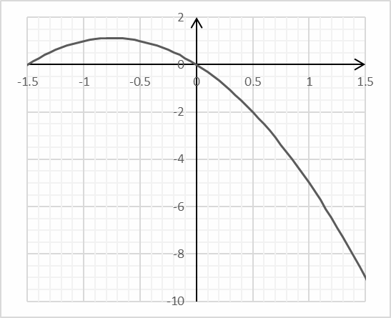
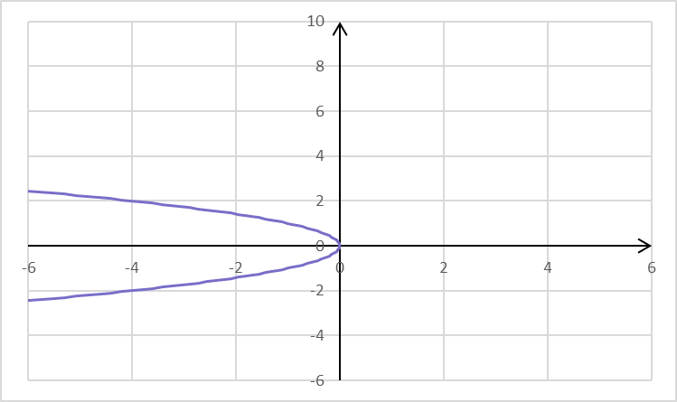
Plot quadratic equations
x |  |  |  | 0 | 1 | 2 | 3
y | -9 | -4 |  | 0 | -1 | -4 | -9
x |  |  |  | 0 | 0.5 | 1 | 1.5
y | 0 | 1 | 1 | 0 | -2 | -5 | -9

