Slide 1
Talking about friends. [1 / 3]
The verbs être and avoir in the 3rd person
French
Mr Hodgson

Slide 2
[ SFE ]
Silent Final E
[shy]
timide

Slide 3
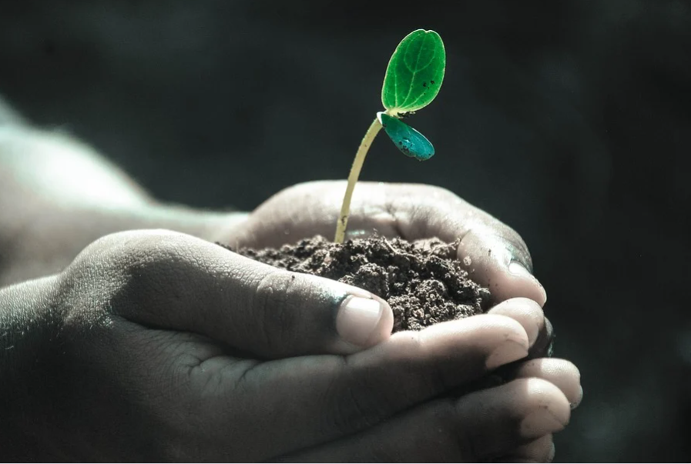
[ SFE ]
Silent Final E
monde
moderne
vie

Slide 4
un(e) ami(e) | a friend
un copain / une copine | a friend
un(e) petit(e) ami(e) | a boyfriend/girlfriend
l’amitié | friendship
agaçant(e) | annoying
drôle | funny
dynamique | lively
fidèle | loyal
gentil(le) | kind
sage | wise

Slide 5
avoir - to have
être - to be
We use ‘avoir’ to describe hair, eyes and age.
We use ‘être’ for personality and size.
J’ai
= I have
Je suis
= I am
Il a/Elle a
= He has/She has
Il est/Elle est
= He is/She is

Slide 6
Talking about friends
The verb avoir means =
He has/she has =
The verb être means =
He is/she is =
We use avoir to describe
We use être to describe =
to have
il a/elle a
to be
il est/elle est
age, hair and eyes
personality and size

