Slide 1
Spanish
Talking to people you know and don’t know [2/2]
- Using ‘tú’ and ‘usted’.
Señorita Vázquez

Slide 2
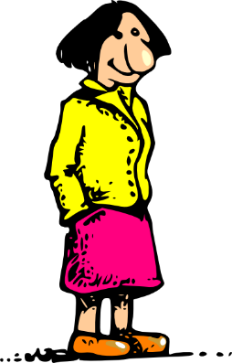
[ñ]
[n]
poner
año
2019
niña
señora
español
mano
planta
tener
nosotros
mañana
[to have, having]
[to leave]

Slide 3
 | Word | English meaning
1 | el trabajo | work, job
2 | llorar | to cry, crying
3 | el papel | paper
4 | acompañar | to accompany, accompanying
5 | el cumpleaños | birthday
6 | dejar | to leave, leaving / to allow, allowing
7 | subir | to upload, uploading
8 | comprender | to understand, understanding

Slide 4
Polite & friendly Spanish: using ‘tú’ and ‘usted’ with -ar verbs
In Spanish the verb ending changes depending on whether we talk to tú (friendly ‘you’) or usted (polite ‘you’).
Polite & more respectful. Use it to talk to an older person or in formal situations.
tú
usted
¿Necesitas una toalla?
¿Necesita una toalla?
Do you need a towel? (friendly)
Do you need a towel? (polite)
So, for regular Spanish verbs ending in -ar (e.g. montar):
Remove -ar and add -as to talk to ‘you’ informally (e.g. your friend).
Remove -ar and add -a to talk to ‘you’ politely (e.g. in a job interview).

Slide 5
Polite & friendly Spanish: using ‘tú’ and ‘usted’ with -er & -ir verbs
Adults always address children as “tú”
tú
usted
¿Tienes un minuto?
¿Tiene un minuto?
Do you have a minute? (friendly)
Do you have a minute? (polite)
So, for regular Spanish verbs ending in -er & -ir (e.g. aprender & descubrir):
Remove -er / -ir and add -es to talk to ‘you’ informally (e.g. your friend).
Remove -er / -ir and add -e to talk to ‘you’ politely (e.g. in a job interview).

Slide 6
In Spanish the verb ending changes depending on whether we talk to a friendly ‘you’ or polite ‘you’. True / False
We use ‘_________’ to talk to someone in a more polite and respectful way and ‘______ ’ is a friendly way of addressing someone.
Select the verb in the ‘usted’ form. a) necesita b) necesitas
Select the verb in the ‘tú’ form. a) aprende b) aprendes
‘¿Tienes un minuto?’ means __________________ and it’s a a) polite or b) friendly way of addressing someone.
Respuestas
usted
tú
‘Do you have a minute?’

