Slide 1
Physics - Key Stage 3 - Energy
Lesson 7: Radiation
Mrs Evans

Slide 2
Independent practice: answer the questions
What process does the sun use to heat the Earth?
How is radiation different to conduction and convection?
What can we use to observe radiation?
What does emit mean?
What does absorb mean?

Slide 3
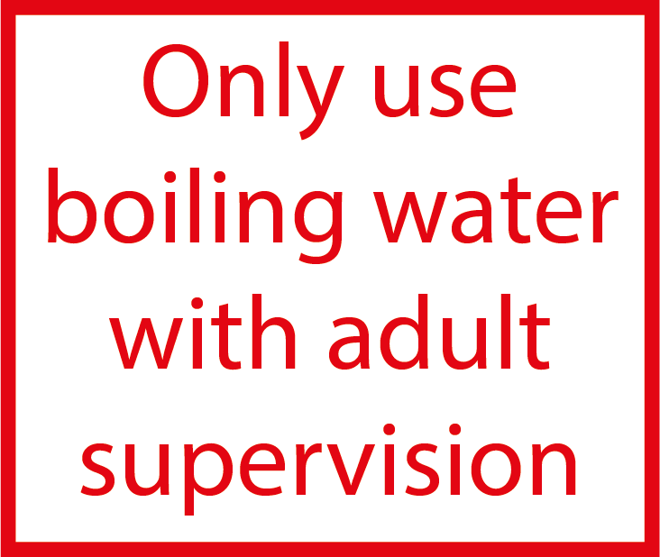
Independent practice: complete the method
Boil the ____?____ , so the water is at 100°C
Fill each ____?____ (1. matt ____?____ and 2. shiny ____?____ ) with 200 ml of water
Position the infrared ____?____ 5 cm away from beaker 1
Record the ____?____
Position the infrared thermometer 5 cm away from beaker 2
Record the temperature

Slide 4
Analysing our results: calculating a mean
Surface type | Temperature (°C)
 | Attempt 1 | Attempt 2 | Attempt 3 | Average (mean)
Black matt | 59.0 | 61.6 | 58.7
Shiny silver | 34.5 | 36.2 | 33.0
To find a mean: add up all your values and divide by the number of values you added

Slide 5
Independent Practice: write a conclusion using the scaffold
Surface type | Temperature (°C)
 | Average (mean)
Black matt | 59.8
Shiny silver | 34.6
The ____?____ surface emitted more radiation.
I know this because ____ ? ____
The temperature for this surface was ____ ? ____ whereas the ____ ? ____ surface had a temperature of ____ ? ____

Slide 6
Independent Practice: Choose a beach volleyball uniform colour and explain your choice
The uniform should be the colour ____ ? ____ because ____ ? ____

