Slide 1
Compare and classify triangles.
Worksheet
Mathematics
Miss Parsons

Slide 2
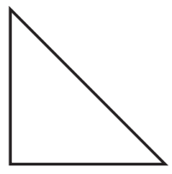
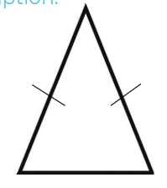
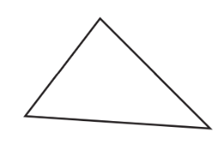
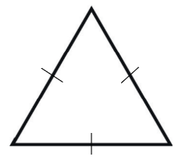
Question 1
Match the triangle to the correct name. One of the triangles will point to two names.
Scalene
Equilateral
Right angle
Isosceles

Slide 3
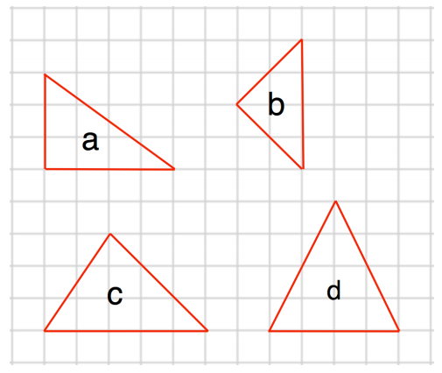
Question 2
Write the letters of the two isosceles triangles.
Corbett maths

Slide 4
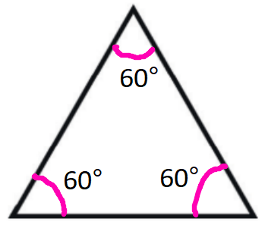
Question 3
What type of triangle is shown?

Slide 5
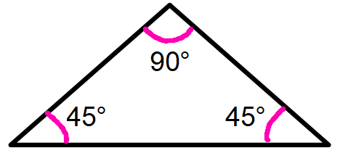
Question 4
What type of triangle is shown?

Slide 6
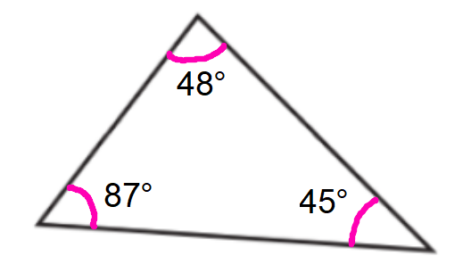
Question 5
What type of triangle is shown?
*not drawn to scale

Slide 7
Question 6
Fatma says:
“I have drawn a triangle with one acute angle, one right angle and one obtuse angle.”
Explain why she is incorrect.

