Slide 1
Lesson 4 - Diffusion
Physics - Key Stage 3
Matter
Mr McKee

Slide 2
Concentration Gradient
Which image will have a faster rate of diffusion?
A
B
Source Mr McKee
Notes:
A larger concentration gradient (difference in the number of particles) will increase the rate of diffusion. Image A will have a slower rate of diffusion compared to image B.

Slide 3
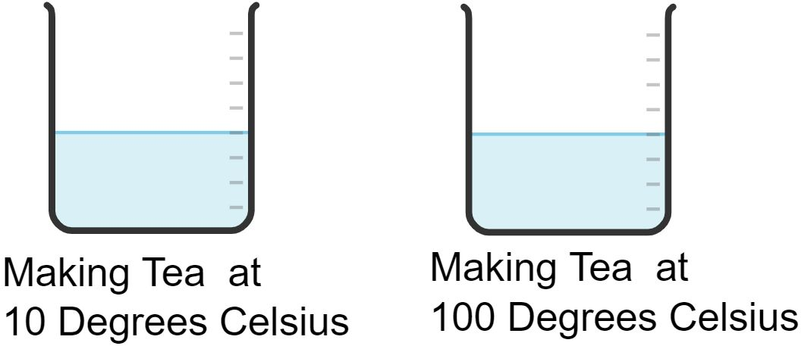
Temperature
Which temperature will have a higher rate of diffusion?
Mr McKee: Created with Chemix
Notes:
Pause
A higher temperature will give the particles more kinetic energy, therefore they will move quicker. Therefore a higher temperature will speed up the rate of diffusion

Slide 4
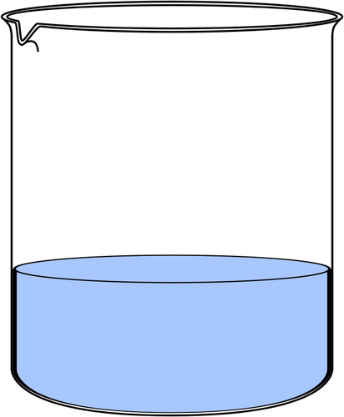
In which of these solutions will diffusion happen more quickly?
30°C
10°C
[Free SVG] - [OpenClipart] - [Water beaker]
Notes:
In the 30 degrees beaker because increased temp speeds up diffusion.

Slide 5
For each picture, in which direction will the particles move?
[Free SVG] - [OpenClipart] - [Water beaker]

Slide 6
Independent Practice Questions.
Define Brownian Motion.
2. Define diffusion.
3. What are the two main factors that would affect the diffusion of a gas, or a substance in a liquid?
4. Why does diffusion happen faster in gases than in liquids?
5. Why does diffusion happen faster when it’s hotter?

