Slide 1
Find the volume of a frustum
Maths
Mr Chan

Slide 2
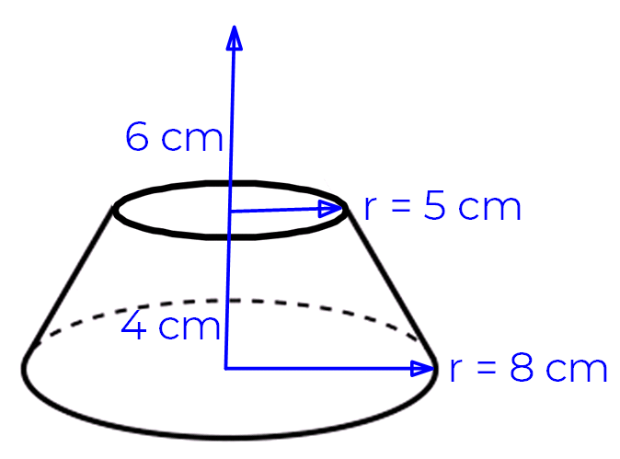
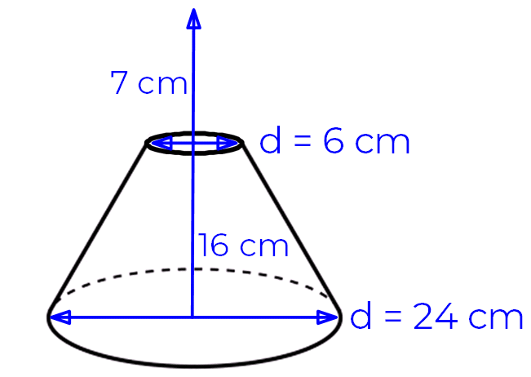
Find the volume of a frustum
1. The diagram shows a frustum. If the side lengths were extended it would form a cone of height 10 cm.
Work out the volume of the frustum.
2. The diagram shows a frustum. If the side lengths were extended it would form a cone with a height of 23 cm.
Work out the volume of the frustum.

Slide 3
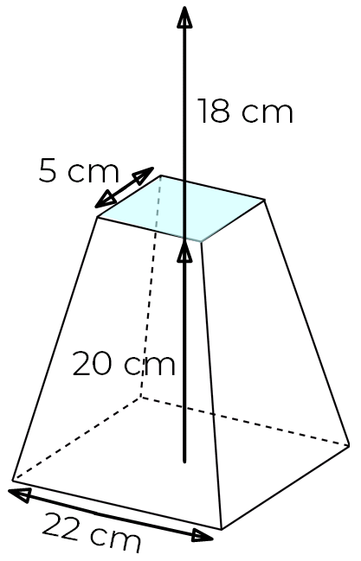
Find the volume of a frustum
3. The diagram shows a
frustum. If the side lengths
were extended it
would form a
square based
pyramid of height 38 cm.
Work out the volume of the frustum.

Slide 4
Answers

Slide 5
Find the volume of a frustum
1. The diagram shows a frustum. If the side lengths were extended it would form a cone of height 10 cm.
Work out the volume of the frustum.
2. The diagram shows a frustum. If the side lengths were extended it would form a cone with a height of 23 cm.
Work out the volume of the frustum.

Slide 6
Find the volume of a frustum
3. The diagram shows a
frustum. If the side lengths
were extended it
would form a
square based
pyramid of height 38 cm.
Work out the volume of the frustum.

